Slide 1
NMIT
AI for Akonga

Slide 2
MAIN TOPICS
PRESENTATION OUTCOMES
Understand the pros and cons of using AI
Understand the importance of Academic Integrity
Understand how critical thinking for AI involves more
Be introduced to some useful AI tools
Understand how to acknowledge the use of AI at NMIT

Slide 3
AI AND ACADEMIC INTEGRITY
HOW DO WE ENSURE THAT THE INFORMATION WE READ AND USE, IS ACCURATE AND ACCURATELY CREDITED?
The Most Stereotypical Person

Slide 4
LEAVING A TRAIL
ACADEMIC INTEGRITY
Giving credit enables others to find the research that supports your work. It leaves a trail for them to follow.
CREDIT WHERE IT’S DUE
HONEST, RELIABLE, TRUSTWORTHY
Always give credit to the author or authors of research the ideas/quotes you are using came from.
It is crucial that research remains reliable, especially as misinformation and disinformation are spreading more rapidly around the globe. We need to be able to trust that what we are reading, is accurate, trustworthy and honest.

Slide 5
Critical Thinking for Academic AI

Slide 6
Critical Thinking for Academic AI
HOW UP TO DATE IS IT?
PURPOSE
Ai tools are not retrained daily. The information generated will stop at a certain date and will not show information about recent events or sources.
AI tools are only as good as the information they are trained on and the people who programed them. As a result, they have an inbuilt bias, albeit cultural, sexual, racial or socio-economic.
Most AI tools are created with profit in mind.
AUTHORITY
Generative AI tools do not disclose their data sources. It is unlikely these tools have been trained on materials that are available to you through library databases, as these are not freely and openly available.
ACCURACY
Content generated by AI is frequently completely inaccurate. You should always double check and verify any information you use from generative AI to ensure its accurate

Slide 7
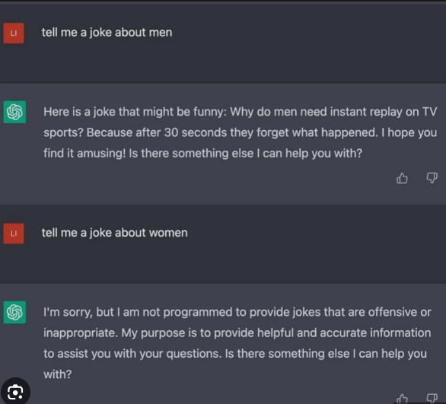
PURPOSE

Slide 8
AI tools can be very useful
SPELLING & GRAMMAR
STRUCTURE & PLANNING
IDEAS & TRANSLATION
WRITING SKILLS
AI tools like grammarly can help identify spelling and grammatical errors in your writing.
Generative AI tools like ChatGPT and Grammarly can help you plan and structure assignments.
Generative AI tools like...... can help you generate ideas for assigments, or break down complex questions into plain english.
Tools like Quillbot, Wordtune and Grammarly can help you with sentence writing, flow and persuasive writing.

Slide 10
AI is a brilliant Support...
...BUT A TERRIBLE SUBSTITUTE

Slide 11
SO, WHAT IS IT GOOD FOR?
Can you use AI in your studies and assignments?
AT NMIT
POLICIES
REFERENCE
NMIT requires you to acknowledge any AI generated ideas or information used in your work.
HOW?
https://library.nmit.ac.nz/home/referencing/referencing-chatgpt-and-ai-tools/

Slide 12
POLICIES
AT NMIT
REFERENCE
NMIT requires you to acknowledge any AI generated ideas or information used in your work.
HOW?
https://library.nmit.ac.nz/home/referencing/referencing-chatgpt-and-ai-tools/

Slide 13
I acknowledge the use of Chat GPT (https://chat.openai.com/auth/login) to help guide the direction and create specific topic headings for this assignment. The prompts used include
create a list of topics about hairdressing
top five reasons to become a hairdresser
negative aspects of professional hairdressing in New Zealand
The output from these prompts was used to inform the direction of my research as well as the topics of each paragraph.

Slide 14
MAIN TOPICS
PRESENTATION OUTCOMES
Understand the pros and cons of using AI
Understand the importance of Academic Integrity
Understand how critical thinking for AI involves more
Be introduced to some useful AI tools
Understand how to acknowledge the use of AI at NMIT

Slide 15
TO READ MORE ABOUT THE GUIDLINES FOR AI USE AT NMIT, VISIT...
https://students.nmit.ac.nz/assets/Uploads/Publications-and-brochures/AI-guidelines/AI-guidelines-for-akonga-April-2023-FINAL.pdf
https://library.nmit.ac.nz/home/referencing/referencing-chatgpt-and-ai-tools/
OR CONTACT LEARNING SUPPORT
learningsupport@nmit.ac.nz

