Slide 1
Supervision in organisations
Supervision in Organisations

Slide 2
Drivers for supervision in the organisational context
Growing focus across disciplines.
Standards set by professional and regulatory bodies.
Focus on workforce development.
Employer liability for duty of care.
Ensure quality of service.
To enable workers to negotiate new roles and responsibilities.
Support system for newly qualified workers.
Notes:
Learning Outcomes on Stream

Slide 3
Warning
It is only good supervision that adds value!
Too often it is assumed that just by having supervision the service will be improved. Supervision only improves outcomes for users, and only adds value for staff, if certain key conditions for its effectiveness are met!
Notes:
Learning Outcomes on Stream

Slide 4
Benefits of effective supervision for organisations
Clearer communication both up and down
Helps maintain professional identity
Greater openness
Agency values and policies disseminated
Lower rates of turnover, sickness, complaints
Improved worker consultation processes
Developing safe, ethical and productive organisations that value their people

Slide 5
Benefits for service users
Worker clearer and more focused
More observant of strengths, needs and risks
More aware of power issues
More able to involve users
More evidence-base assessments
Consistency
Clearer plans
Notes:
Strong Kavanagh et al- benefits- prof devlpmet and support, quality assurance, best practice
Hist origins- Kierans article Munson, Kadushin, influence managerialism- interchangeable use of clinical/professional

Slide 6
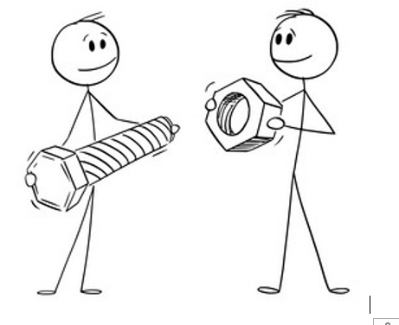
Benefits for Workers
Role and accountability clearer
Boundaries clarified
Pressures shared
Confidence enhanced
Judgements reflected on
Diversity valued
Poor practices challenged
Learning needs identified
Feelings addressed
Worker valued not isolated
Creative practice supported

Slide 7
Benefits for multidisciplinary work
Identifying appropriate expectations of others
Ensuring workers communicates with and listens to other agencies
Preparing workers for MDT meetings
Appreciating of different roles, challenging stereotyping
Help workers to interpret other agencies
Assist in mediating conflicts with other agencies, or negotiating over resources

Slide 8
The benefits and outcomes of effective supervision

Slide 9
Common Barriers to Supervision
Lack of agency policies or standards
Confusion on definitions
Lack of time and space
Case management rather than a developmental focus
Domination of managerial and accountability elements
Confusion between consultation and supervision
Little or no quality assurance process
Inadequate preparation of supervisees
Notes:
Request from 2014 that groups are rotated so people not always working with the same people

Slide 10
Consequences of poor supervision for staff
Unclear expectations
Lack of accountability
Reduced competence
Professional development impaired
Judgements unchallenged
Feelings unprocessed
Isolation
Dysfunctional team dynamics
Inappropriate worker autonomy

Slide 11
What does your agency policy say?
Clear definition linked to agency goals/values
Explicit links between supervision and needs/outcomes for service users
Clarify expectations, frequency, location, recording
Clarify limits for confidentiality
How supervision can promote indiscriminatory practice
Clear role, tasks, rights and responsibilities for supervisor and supervisee
Provides for situations where the supervisory relationship has broken down
Provide a framework for the selection and training of supervisors
Standards to audit the quality of supervision

Slide 12
Complex relationships between different stakeholders
Multi-disciplinary Service User
Organisation Worker
Four Functions
Normative / Admin
Formative /Education
Restorative /Support
Mediation

Slide 13
Mapping the organisational context

Slide 14
References:
Davys, A., & Beddoe, L. (2021). Best practice in professional supervision. Jessica
Kingsley.
Hawkins, P., & Shohet, R. (2006). Supervision in the helping professions
(3rd ed.). Open University Press.
Morrison, T. (2005) Staff supervision in social care. Pavilion Publishing.

