Slide 1
The supervision relationship
PPS802 Professional Supervision

Slide 2
THE SUPERVISION RELATIONSHIP – The beginning
Supervision is ‘strongly influenced by infrastructure and relationship variables. In other words, the performance will be as good as the attention that is paid to these seemingly extraneous variables’ (Bernard, 2005, p.9). The beginning stage of a supervision relationship is characterised by two activities: establishing ‘fit’ and negotiating the supervision contract.
(Davys & Beddoe, 2021)

Slide 3
A resonant relationship
“A relationship that truly attunes and resonates for both parties is transformational because it allows us to meet one another at a soul level free from the constraints that fear evokes in us, constraints that block our creativity and capacity to learn”.
(Adamson, 2011, p. 87)

Slide 4
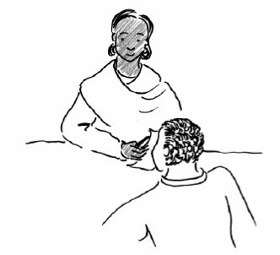
A learning partnership. Its supports learning and unlearning.
(Carroll, 2010)

Slide 5
A negotiation
“Regardless of whether or not we have a choice of supervisor, we do have choices about how we negotiate the supervision we receive…”
(Davys, 2007, p.30)

Slide 6
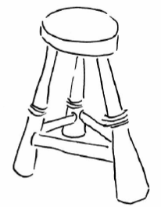
Negotiating an effective supervision contract
The negotiation of the supervision relationship and contract/agreement can be considered as the process of working through three key areas:
Administrative – frequency, time, venue, recording..
Professional – purpose, focus, principles, roles & responsibilities, accountability..
Psychological – motivation, commitment, ownership, investment..

Slide 7
Four stages of setting up a supervision relationship
Mandate
Engagement
Acknowledging ambivalence
Written Contract
(Morrison, 2005, p.116)

Slide 8
Mandate
The ‘right to act’. Without a clear mandate the basis for their authority and activity is unclear. The authority relationship cannot be negotiated if the source and extent of the supervisor’s authority is unspecified. Morrison, (1993)
Our mandate suggests what our rights and responsibilities are in our respective roles.

Slide 9
Key issues at the mandate stage
What is non-negotiable?
What is negotiable?
Who has what rights to expect what from whom in supervision?
What responsibilities does each have in supervision?
What are the boundaries around, and limits to, confidentiality?
What is the difference between supervision and consultation/adhoc/open door?
What records are to be maintained in supervision, who keeps them and who can see them for what purpose?

Slide 10
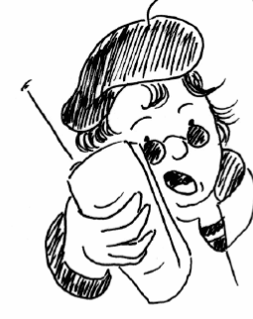
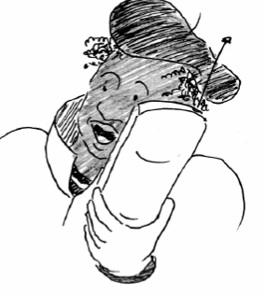
Engagement
Mandate does not necessarily lead to engagement. Engagement occurs when there is a shared perception of and commitment towards supervision by both parties….
What would you like to know about your supervisee?
What would you like to know about your supervisor?

Slide 11
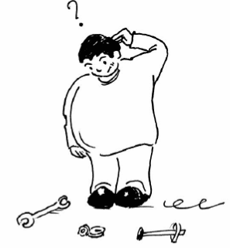
Key Areas to explore at the engagement stage:
What is your understanding of supervision?
Previous experiences of supervision – what worked, what did not?
Expectations regarding the handling of power and authority?
Learning styles
The approach each brings to the work?
NB. This list includes areas for both the supervisor and supervisee to explore.
Supervision is a collaborative process

Slide 12
Acknowledging Ambivalence and resistance
No matter how committed the supervisee is to supervision and to exploring practice, there will always be unforeseen barriers. Often these can trigger emotional responses to situations:
Personal impacts of cases/patients causing sadness, despair or fear
Moral dilemmas – intolerance to behaviors
Lack of time and resources
Mismatch between expectations of the job and realities
Quality of current supervisory experiences with previous negative ones
(Morrison, 2005)

Slide 13
Contracting
The supervision contract, is generally agreed, underpins and defines the parameters of any supervision arrangement and provides a structure for the relationship (Davys & Beddoe, 2021)
A means of making explicit the aims of the parties to work towards agreed goals in agreed ways. (Morrison, 2005)

Slide 14
Contracting continued….
What do we need to make explicit and agree on both verbally and written?
Agency policy with template for consistency
Personally developed
Rule of thumb:
1. Has been negotiated
2. Addresses issues and how they will be managed
3. Is co-signed and dated
4. Is copied for both supervisor and supervisee
5. Is reviewed at least annually

Slide 15
References
Adamson, C. (2011). Supervision is not politically innocent. Australian Social Work, 65(2), p. 185-196.
Carroll, M. (2010). Supervision: Critical Reflection for transformational learning, part 2. The Clinical Supervisor, 26(1), 1-19.
Davys, A. (2007) Active participation in supervision: A supervisee’s guide. In Wepa, D. (ed.). Clinical Supervision in Aotearoa/New Zealand: A health perspective. 26-42. Auckland: Pearson Education.
Davys, A., & Beddoe, (2021). Best practice in professional supervision: A guide for the helping professions (2nd edn.). Jessica Kingsley.
Morrison, T. (1993) Staff Supervision in Social Care. Harlow: Longman.
Morrison, T. (2005). Staff supervision in social care: Making a real difference for staff and service users. Brighton, England: Pavillion.

