Slide 1
Workshop 1: A platform of understanding.
PPS802 Professional Supervision 2024
NMIT / TE PUKENGA

Slide 2
What we consider to be the nature of supervision, what we think the purpose of supervision is, will then determine all else…. the supervision relationship we seek to establish, the theories we draw on to guide us etc.…
Developing an understanding of supervision as a platform to our supervision practice.
Notes:
At the risk of stating the obvious it is important of establish a clear understanding of what supervision is to ‘sit under our practice as everything else flows from this e.g.: what type of supervision relationship we establish….’

Slide 3
It can be a fraught task however…!
Grauel’s (2002) asserts that supervision is ‘a malleable concept in search of precise definition’ (Grauel 2002, p. 4).
Milne et al. (2008) captures the lack of agreement between professions (and sometimes within professions) about the definition of professional supervision.

Slide 4
Developing an understanding of supervision as a platform to practice
Our own experiences of supervision that shape your understanding | The terrain or complex landscape of supervision | The literature and theoretical models with regards to their underpinning premises about the nature of supervision | Our context – how this shapes, determines, influences, makes way for the purpose of supervision

Slide 5
Common premises about supervision
mandated by and accountable to organization, profession and/or individual
on-going and regular (a process rather than an event)
is educative (but not education)
involves accountability, but it is not management or appraisal
supportive but it is not counselling
focused on the supervisee’s agenda
about critical reflection and learning for improved practice and service delivery
about ongoing professional development of practitioner
about development of practitioner knowledge, skills and competence
involves power and authority
is ethical and confidential
Davys (2007)

Slide 6
Common premises about what it is not
A chat session
Gossip
Friendship
Counselling
Management
For the supervisor to talk about his or her issues
Appraisal
Judgemental
Davys (2007)

Slide 7
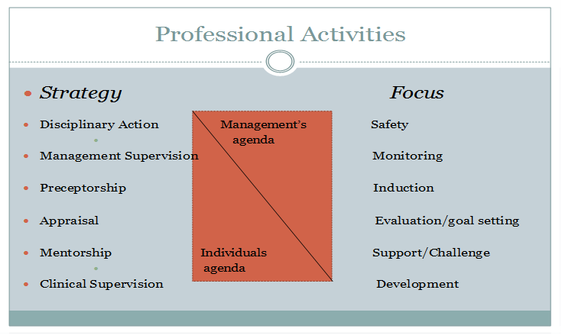
Where does supervision fit with the range of other activities that have a supervisory focus?
Northcote (2002)

Slide 8
Clarification of terms
Professional Supervision
Clinical Supervision
primarily focuses on clinical practice and should be provided by a registered practitioner with suitable experience, knowledge and skill that will enable the growth and development in the clinical skills domain of the practitioner.
…Professional supervision is between those who share the same professional background and training and is central to many professionals employed in health, psychological and social services.
Profession supervision is generally between two people and assists practitioners to increase their understanding of oneself; one's relationships with others; to develop more fulfilling and more resourceful ways of providing : and to bring about change in professional behaviour and practice.
Davys, et al. (2021)
Adapted from Simmons, Carlsson et al. (2007).

Slide 9
Interprofessional supervision
Interprofessional supervision (IPS) is with a supervisor and supervisee who do not share the same profession (Davys et al.,2021)
  Interdisciplinary [Interprofessional ] supervision can be defined as two or more [practitioners] meeting from different professional groups to achieve a common goal of protecting the welfare of the client. This protection is achieved through a process that enables increased knowledge, increased skill, appropriate attitude and values….to maintain clinical and professional competence (Townsend, 2005, p.586)

Slide 10
Kaupapa Māori Supervision
“ …..a framework where the supervision philosophy and functional process is grounded in a Māori worldview and asserts the validity and self-determination of Māori practices as a pathway towards Māori development and wellbeing “ (Eruera ,2012,p. 18).
Cultural Supervision
Supports awareness of own practice with particular ethnicities which may include aspects of kaupapa Māori approaches for Tauiwi working with Tangata whenua. Cultural supervision supports and maintains the interplay of cultural, social and professional identity (Eketone, 2012)
Notes:
As
such many Mäori practitioners who are committed to improving the ‘ora’ of whänau they
work with may compromise their own ‘oranga’ or wellness if not fully supported through
effective supervision. Although as Mäori we are diverse in our thinking and experiences, a
tangata whenua supervision framework with foundation principles can provide a guide to
support kaiärahi in their practice context. It can assist to facilitate a process for the practitioner
in coming to terms with these realities in order to find a place of personal and professional
satisfaction in their practice.” Eruera (2012, p. 13)

Slide 11
Parameters
What is the difference between supervision and counselling (EAP)?
What is the difference between clinical/professional supervision and line management supervision?
The focus of supervision is on professional
not personal identity. Personal change for
practice development not for ‘its’ own sake.
The supervisor, unlike the therapist, does not
suspend critical judgement and supervision operates
within the boundaries of performance expectations
and standards established by professional and
organisational bodies. Fox 1989
Line management involves hierarchy and the monitoring of performance to meet organizational goals and has a responsibility to make sure employee has what they need to do the job. There is a far greater organizational agenda in line management supervision.
A dual role of line management may coexist in supervision.

Slide 12
Theoretical and Philosophical positions and the underpinning emphases as to the nature of supervision….
Supervision is an inquiry into practice. It is a compassionate appreciative inquiry…In supervision we re-write the stories of our own practice… supervision interrupts practice. It wakes us up to what we are doing. When we are alive to what we are doing we wake up to what is, instead of falling asleep in the comfort stories of our clinical routines’
Ryan, S. (2004) Vital Practice, Portland, USA. Sea Change Publications. p. 44.
The heart of supervision is learning. The medium of learning in supervision is reflection. The focus of reflection in supervision is the work or practice of the supervisee.
Carroll, M. (2010) Supervision: Critical Reflection for Transformational Learning (Part 2), The Clinical Supervisor, 29:1–19

Slide 13
References
Davys, A., Fouche, C., & Beddoe, E. (2021) Mapping effective interprofessional supervision practice. The Clinical Supervisor: 40(2) 179-199.
Davys, A. (2007). Active participation in supervision: A supervisee's guide In D. Wepa (Ed.), Clinical Supervision in Aotearoa/New Zealand: A Health Perspective (pp. 26-42). New Pearson Ed.
Eruera, M. (2012) ‘He Korero Korari ‘. Aotearoa New Zealand Social Work, (24), 3 &4, 12-19.
Grauel, T. (2002). Professional Oversight: the neglected histories of supervision. In: M. McMahon & W. Patton (Eds.), Supervision in the Helping Professions: a practical approach. (pp. 261-271). Prentice Hall.

Slide 14
Eketone, A. (2012). The purposes of cultural supervision. Aotearoa New Zealand Social Work, 24(3&4),
20-30.
Fox, R. (1989). Relationship: The cornerstone of clinical supervision. Social Casework, 70, 146-152.
Milne, D., Aylott, H., Fitzpatrick, H. & Ellis, M. V. (2008). How Does Clinical Supervision Work? Using a 'Best Evidence Synthesis' Approach to Construct a Basic Model of Supervision.
The Clinical Supervisor, 27(2),170 - 190.
Morrison, T. (2005). Staff supervision in social care: Making a real difference for staff and service users.
Pavillion.
Northcott, N. (2000) ‘Clinical Supervision: Professional development or management control.’ In J.
Spouse & L. Redfern (eds.)Successful supervision in health care practice. (pp. 10-29)
Blackwell Science
Ryan, S. (2004) Vital Practice. Sea Change Publications.
Townsend, M.(2005) Interprofessional supervision from the perspectives of both mental health nurses and other professionals in the field of cognitive behavioural psychotherapy. Journal of Psychiatric & Mental Health Nursing, 12(5), 582-588.

