Slide 1
The Functions of Supervision

Slide 2
Three Functions of Supervision
Formative function
Restorative Function
Normative function
Interactive Model Proctor & Inskipp (1993)

Slide 3
The tasks of the supervisor in each function of supervision
Restorative …. concerned with how the supervisee responds emotionally to the stresses and demands of working in the health care environment
Normative ....concerned with maintaining and monitoring the effectiveness of the supervisee’s everyday health care work.
Formative …..concerned with the continued development of the skills, abilities and understandings of the supervisee through regular reflection on practice working in the health care environment.

Slide 5
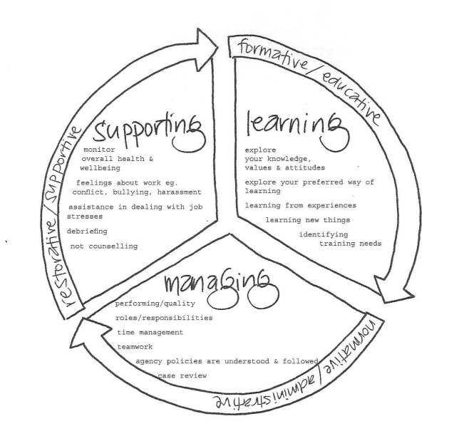
Developed by Rod Baxter & Trissel Mayor’s Supervision Scrapbook (for supervisors working with young people)
This is based on the work of counselling's Bridget Proctor (1988) and social works Kadushin (1992)

Slide 7
References:
Baxter, R., & Mayor, T. (n.d). Supervision Scrapbook.
Fox, R. (1989). Relationship: The cornerstone of clinical
supervision. Social Casework, 70, 146- 152.
Inskipp, F., & Proctor, B. (1993). Making the most of supervision: A professional development resource.
Kadushin, A., & Harkness, D. (2002) Supervision in Social
Work. University of Columbia Press.
Morrison, T. (2005). Staff supervision in social care: Making a real difference for staff and service users.
Pavilion.

