Slide 1
Writing at Post Graduate Level.
HSHS802 Professional Supervision 1

Slide 2
Bloom (1956) Taxonomy of Learning

Slide 3
General Expectations of Writing at NZQA Levels
Level 8-9 Post Graduate
Level 7 Degree
Level’s 5-6 Diploma
Level’s 2-4 Certificate

Slide 4
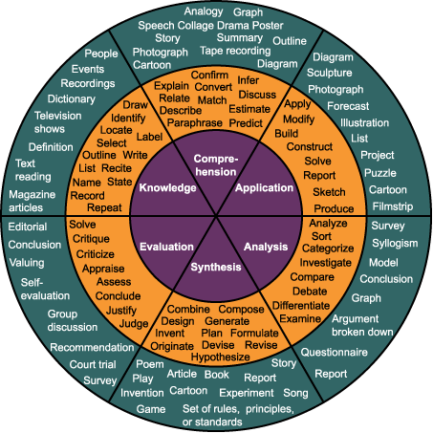
Bloom (1956) Taxonomy of Learning

Slide 5
Why Critical Thinking?
What is critical thinking?
Does critical thinking improve clinical competence?
Does it develop us as supervisors?
How do we develop our writing to be more critical than descriptive?

Slide 6
Heath (2012) draws on the following to define critical thinking…..
‘the art of analysing and evaluating thinking with a view to improving it’ (Paul and Elder cited by hooks, 2010.p9).
‘the habit of making sure our assumptions are accurate and that our actions have the results we want them to have’ (Brookfield,2012, p14.).

Slide 7
Planning your essay
Jot down
any experiences that come to mind that relate to the topic
what do you notice/what do these mean to you?
any issues/questions/wonderings that arise for you that you would like to explore
any knowledge comes to mind.
generate six discussion points.
identify your thinking and engage in a critical process around your thinking using literature to help and support you.
write this down- making sure you orientate the reader throughout.

Slide 8
Some ways to think critically
Consider what the evidence is for the thinking/claim
What is being assumed in the situation/claim
Consider counter theories or alternative perspectives
Consider the ‘silences’ . Consider the inherent power positions.
Capture implicit messages
Examine – bias or collusion in the claim.
Consider in connection to ethic of care in relationships.
Consider how we might improve our thinking and actions
Adapted from Heath (2010).

Slide 9
References
Bloom, B. (1956). Taxonomy of Education Objectives. See http://inventors.about.com/library/lessons/bl_benjamin_bloom.htm
Brookfield, S. (2012). Teaching for Critical Thinking Tools and Techniques to Help Students Question Their Assumptions. San Francisco, USA: Josey-Bass.
Heath, M. (2010) On critical thinking. The International Journal of Narrative Therapy and Community Work. 2012.no.4 pp. 11-18. www.dulwichcentre.com.au
hooks, b. (2010) Teaching Critical Thinking in Practical Wisdom. New York, USA: Routledge.

