Slide 1
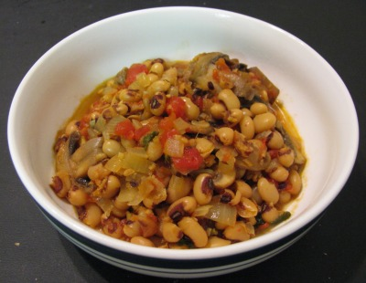
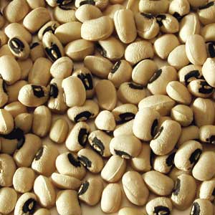
BLACKEYED BEANS
Creamy white bean with a brownish, black eye
Soups, stews

Slide 2
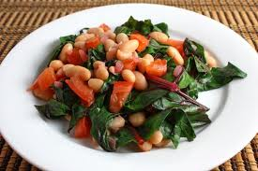
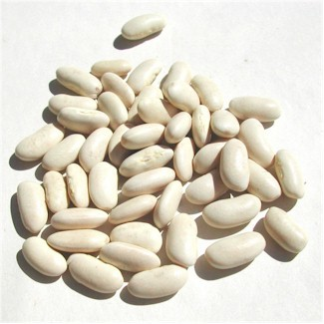
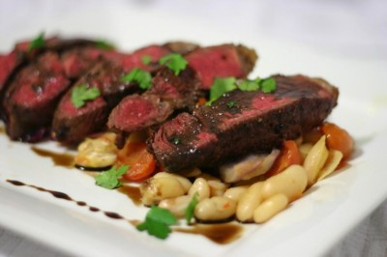
CANNELLINI
White bean, popular in Italy
Similar to haricot. Fluffy and creamy.
Popular in tuna dishes, bean salads, vegetarian dishes

Slide 3
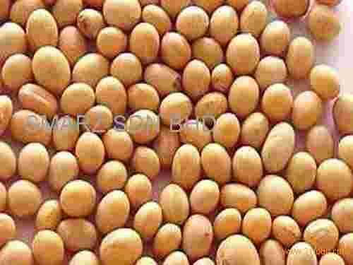
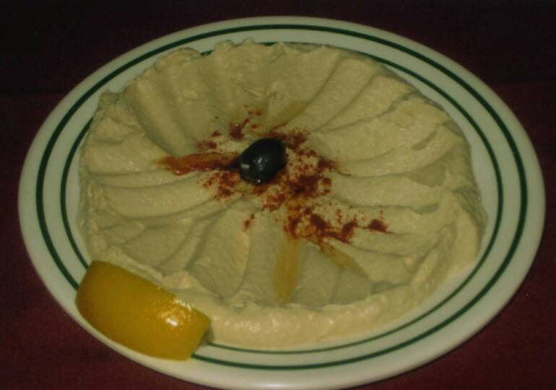
CHICKPEAS
Light brown, round seed
Dahl, soups, hummus, patties

Slide 4
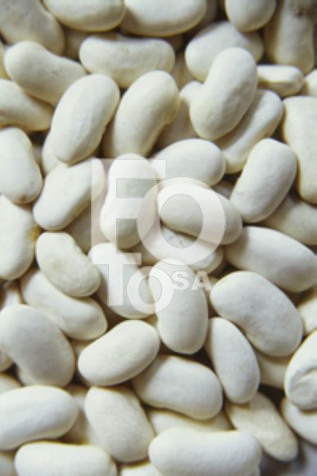
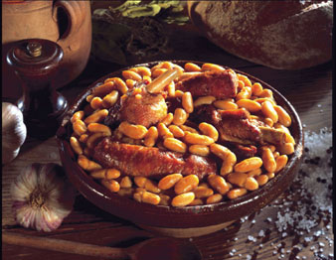
HARICOT
White, smooth, oval bean
Used in casseroles and stews

Slide 5
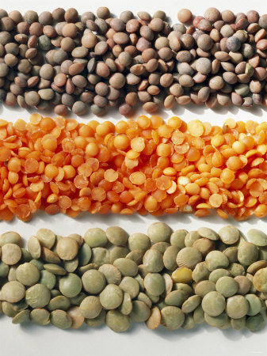
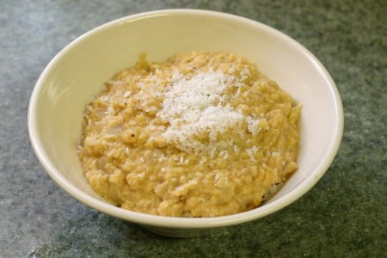
LENTILS
Small disc shaped pulse ( similar to the lens of an eye) Red, orange, brown
Used in vegetarian dishes, soups

Slide 6
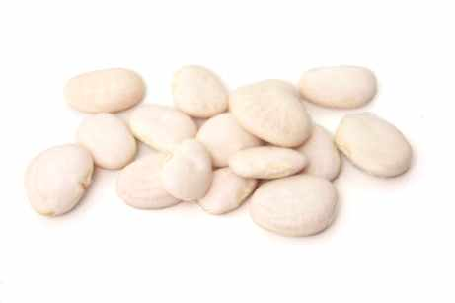
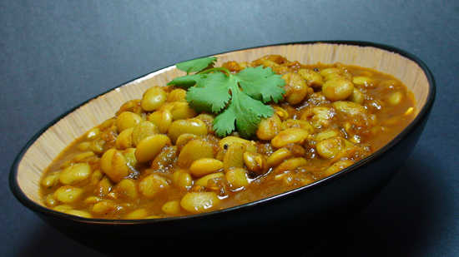
LIMA/ BUTTER BEANS
White, oval bean, buttery flavour
Harder to digest than other beans. Soups and stews

Slide 7
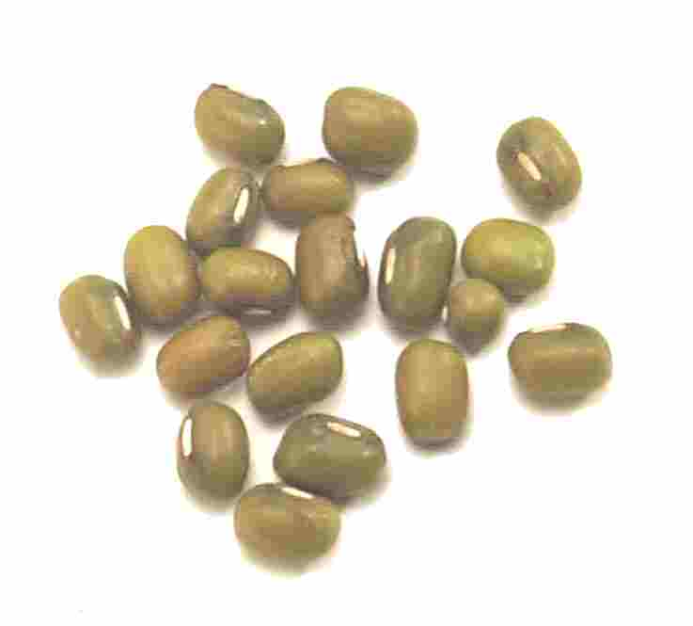
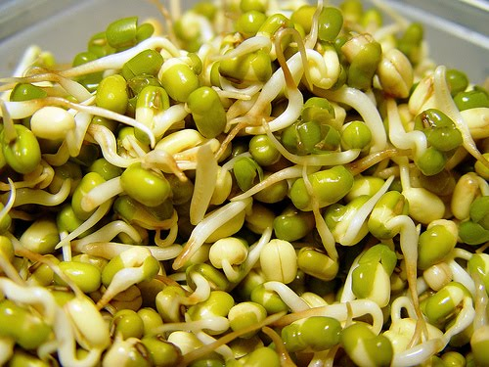
MUNG
Tiny, round olive green seed
Sprouted for salads, garnish

Slide 8
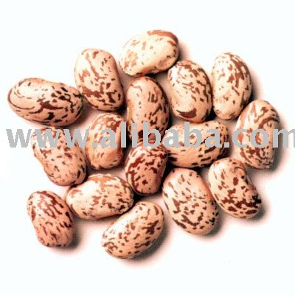
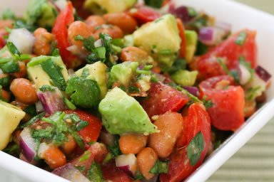
PINTO BEANS
Brown splashes disappear when cooked. Good source of iron
Salads, soups, stews

Slide 9
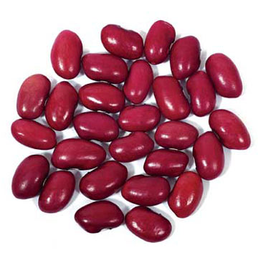
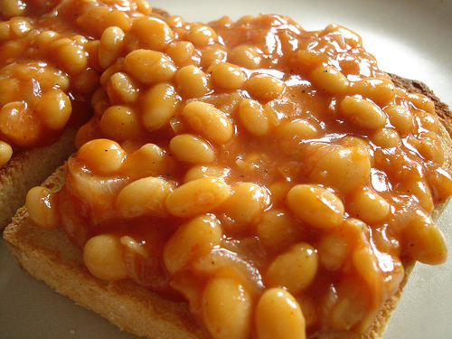
RED KIDNEY
Wine red, plump, oval bean
Canned, dried, used in baked beans, chilli con carne

Slide 10
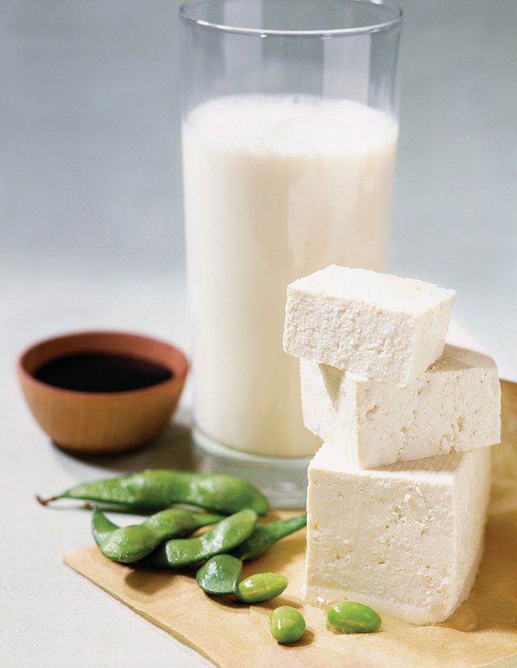
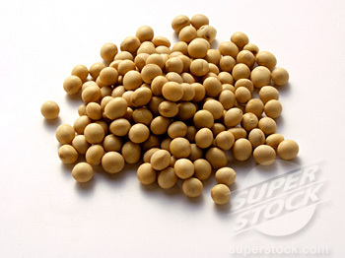
SOYA BEANS
Medium sized, round bean, rich in protein, vits and minerals
Vegetarian dishes, soy milk, soya oil, TVP

Slide 11
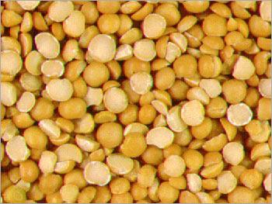
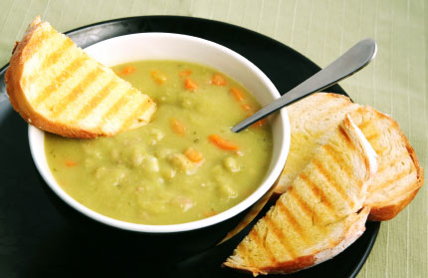
SPLIT PEAS
Yellow or green, round pea, split in half
Used in soups, stews. Does not need to be soaked before use

Slide 12
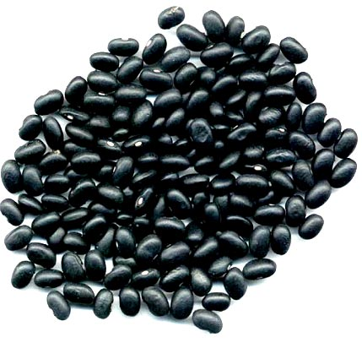
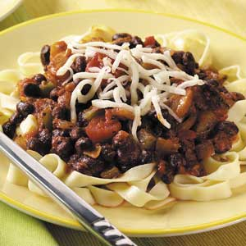
BLACK BEANS
Small round shiny, oval black bean
Mexican beans, used with burritos , baked potatoes

