Slide 1
OILS

Slide 2
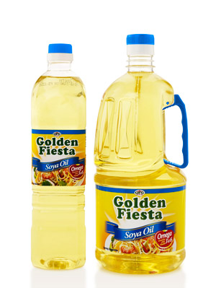
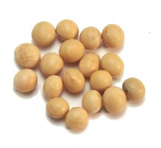
SOYA OIL
Pale, golden oil
Frying and vegetable oil

Slide 3
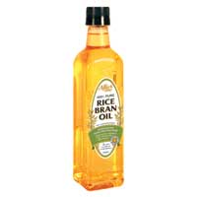
RICE BRAN OIL
High Vit E
High smoke point
Versatile
Made into margarines

Slide 4
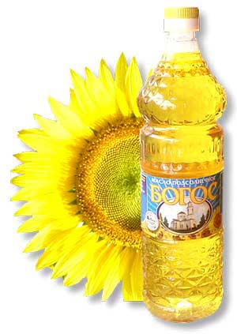
SUNFLOWER OIL
Light in colour
Neutral taste
Used for salad and cooking oil
Margarine

Slide 5
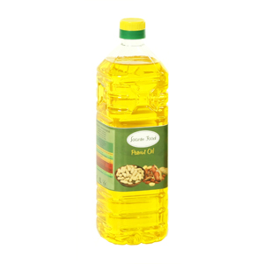
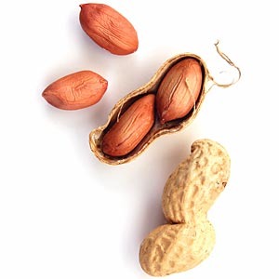
PEANUT OIL
Light golden oil
Delicate and nutty
Frying and dressings (beware of allergies)

Slide 6
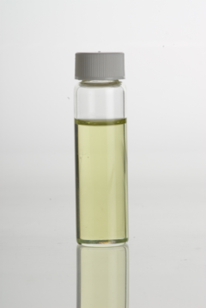
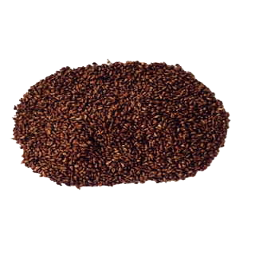
GRAPESEED OIL
Light, fruity oil from grapeseeds ( by product of winemaking)
Dressings and drizzlings

Slide 7
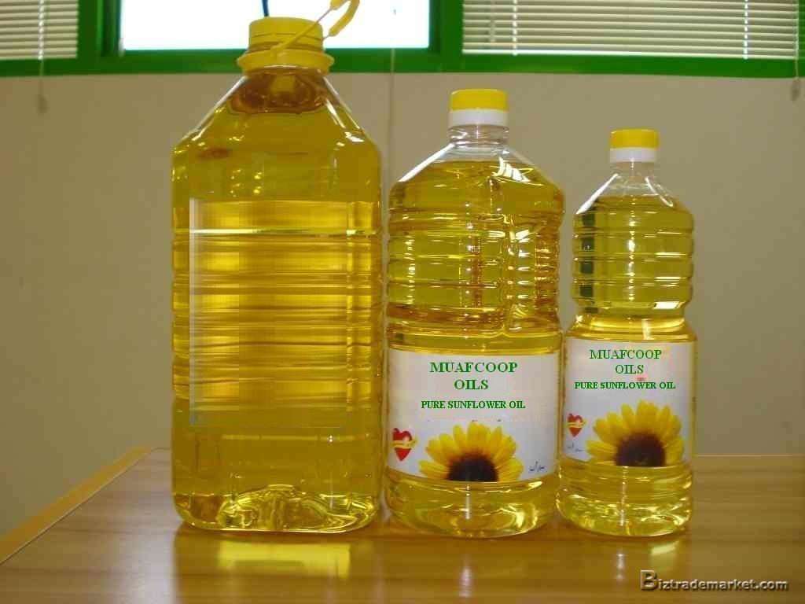
CANOLA
Good every day oil
High omega 3’s
Called vegetable oil in the UK

Slide 8
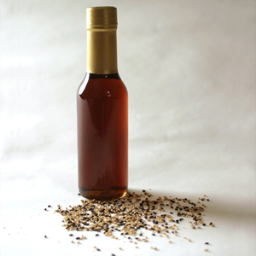
SESAME OIL
Thick dark oil from toasted sesame seeds.
Strong nutty flavour
Frying- Asian
Drizzling

Slide 9
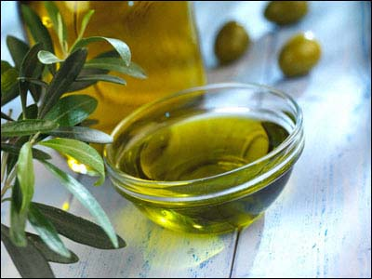
OLIVE OIL
Colour ranges from green-yellow
Different pressings, can be acidic
Frying and dressings

Slide 10
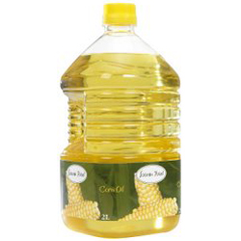
CORN OIL
Yellow oil, neutral
Frying and margarine

Slide 11
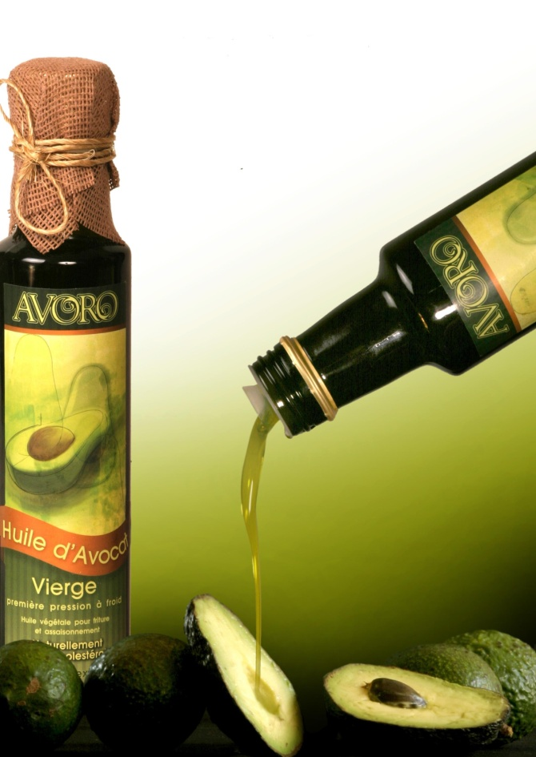
AVOCADO OIL
Rich, green oil from avocado flesh
Dressings, drizzling (use instead of olive oil)

Slide 13
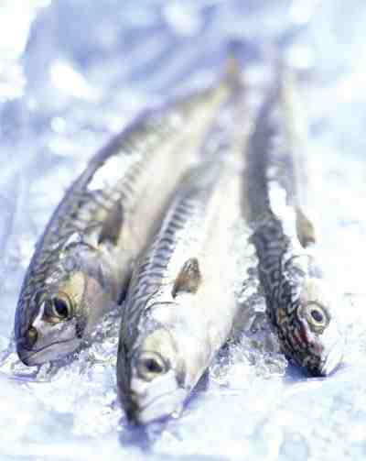
FISH OIL
Mostly from dried fish
Very intense taste
Frying, adding background taste

Slide 14
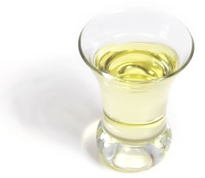
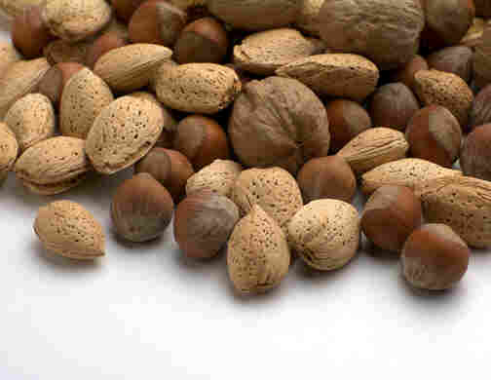
HAZELNUT OIL
Light, nutty oil
Salads and vinegrette

Slide 15
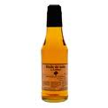
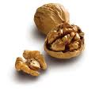
WALNUT OIL
Dark, golden oil from toasted walnuts
Salad and drizzling

