Slide 1
FUNCTION OF EGGS IN COOKING

Slide 2
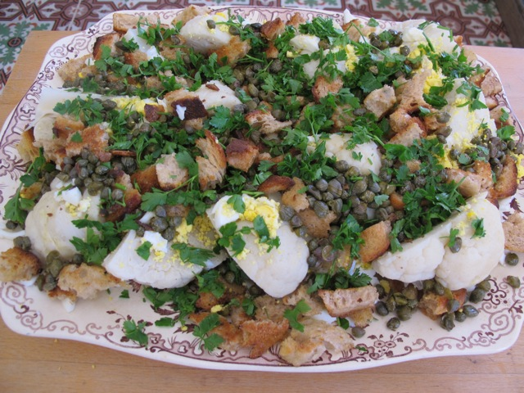
GARNISHING
Gives colour or finish

Slide 3
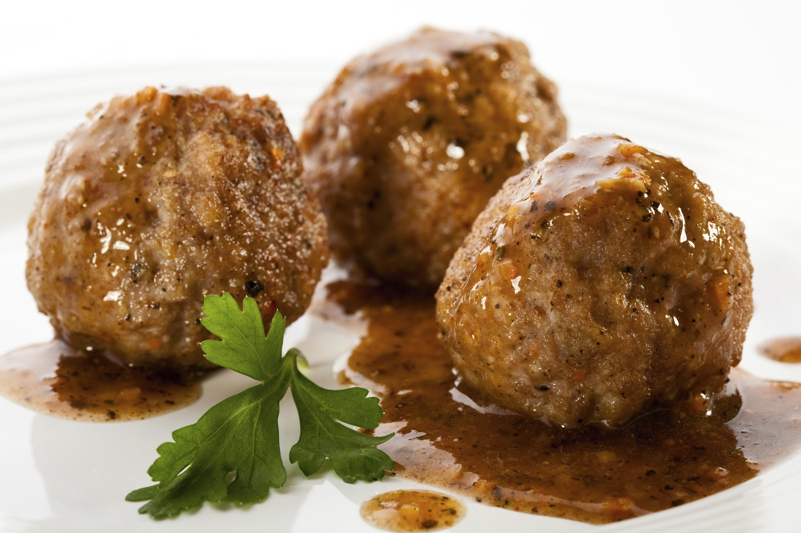
BINDING
Holds things together

Slide 4
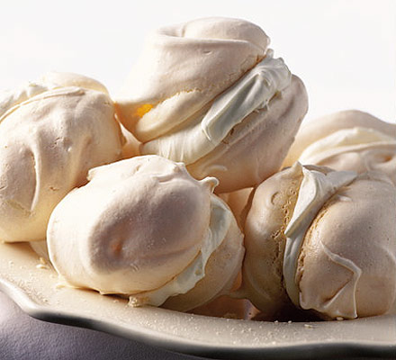
RAISING
Makes things rise

Slide 5
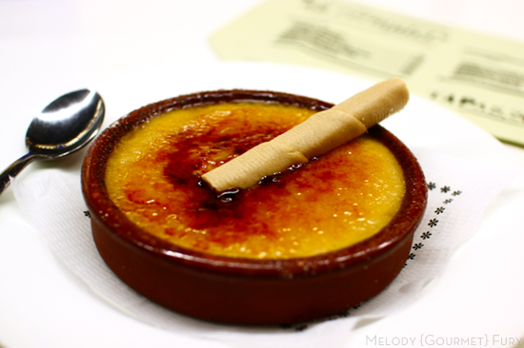
THICKENING
Makes things thicken

Slide 6
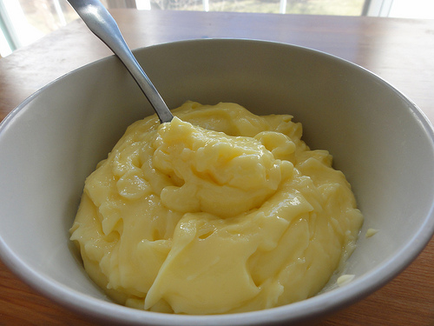
EMULSIFIER
Binds liquid and oil

Slide 7
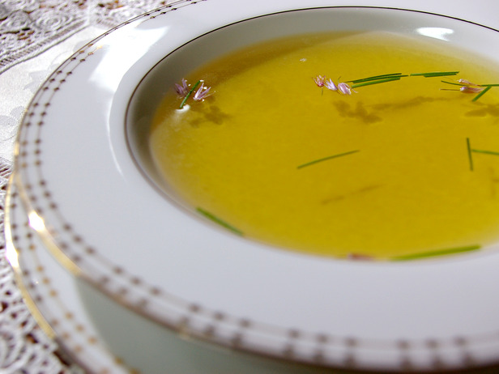
CLARIFIER
Absorbs tiny particles

Slide 8
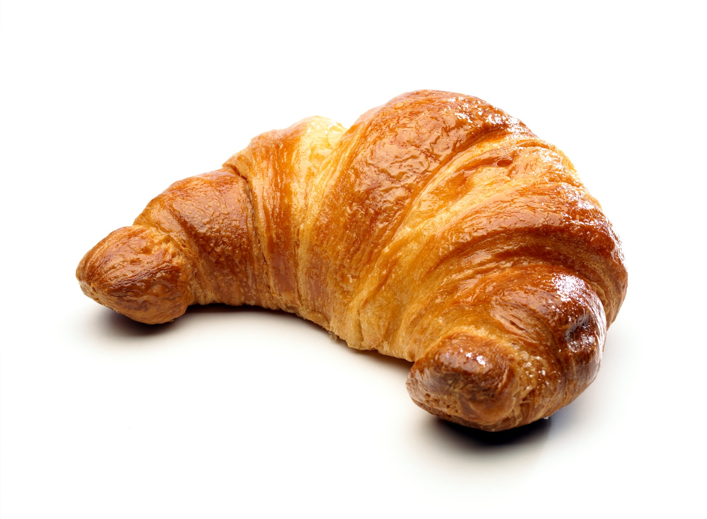
GLAZE
Adds gloss

Slide 9
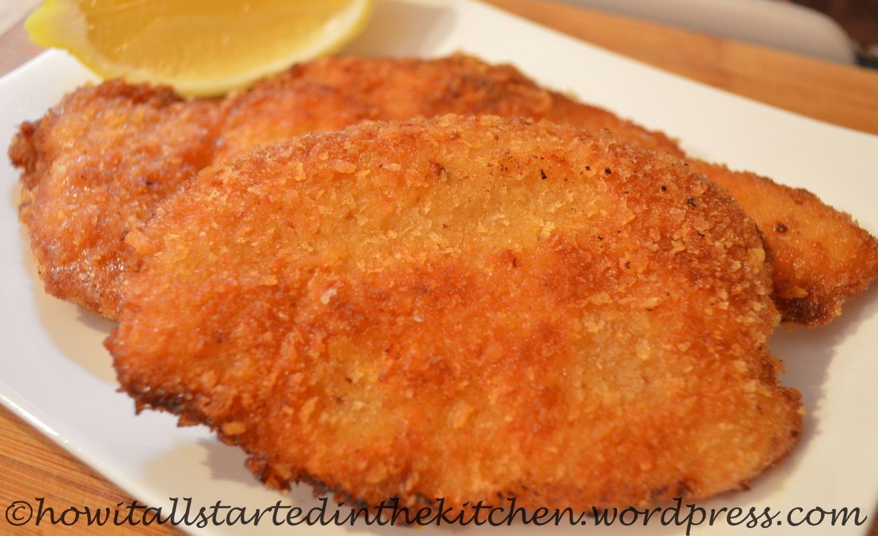
COATING
Holds a coating

Slide 10
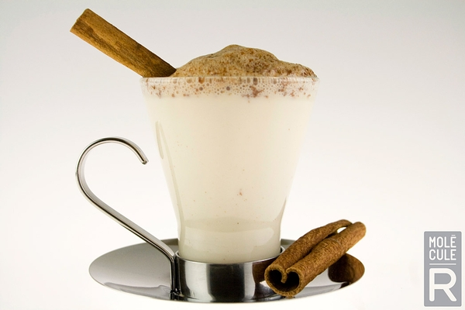
ENHANCING NUTRITIONAL VALUE

