Slide 1
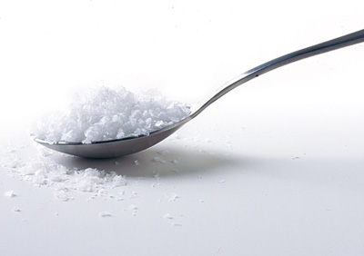
SALT

Slide 2
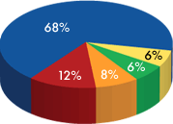
USES OF SALT

Slide 3
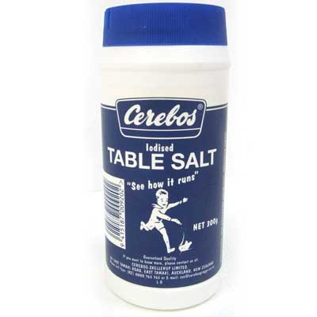
IODISED TABLE SALT
Not suitable for manufacturing, turns foods black

Slide 4
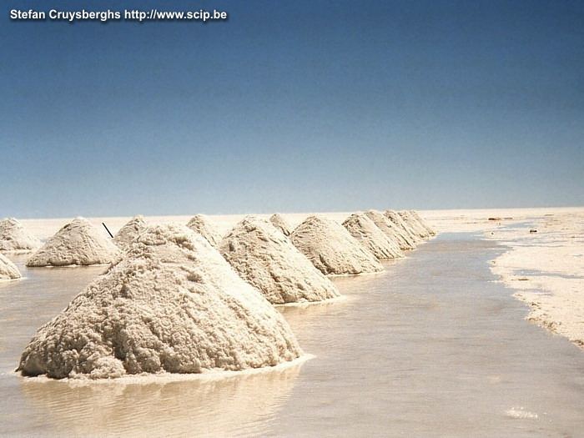
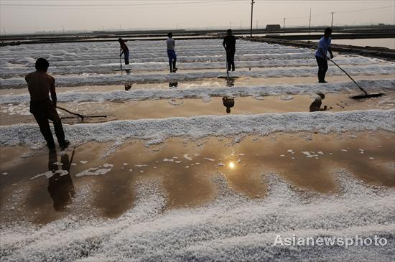
SEA SALT
Solar evaporation
Delicate crystals
Dissolves easily

Slide 5
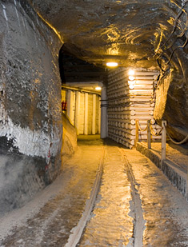
ROCK SALT

Slide 6
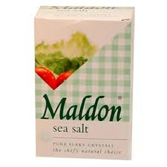
MALDON SALT
Collected from estuary water
Clean fresh taste
No bitter after taste
Soft, white flakey crystals

Slide 7
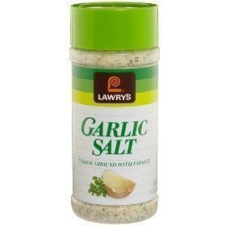
GARLIC SALT
3parts salt to 1 part garlic plus anti-caking agent
Seasoning e.g hamburgers

Slide 8
