Slide 1
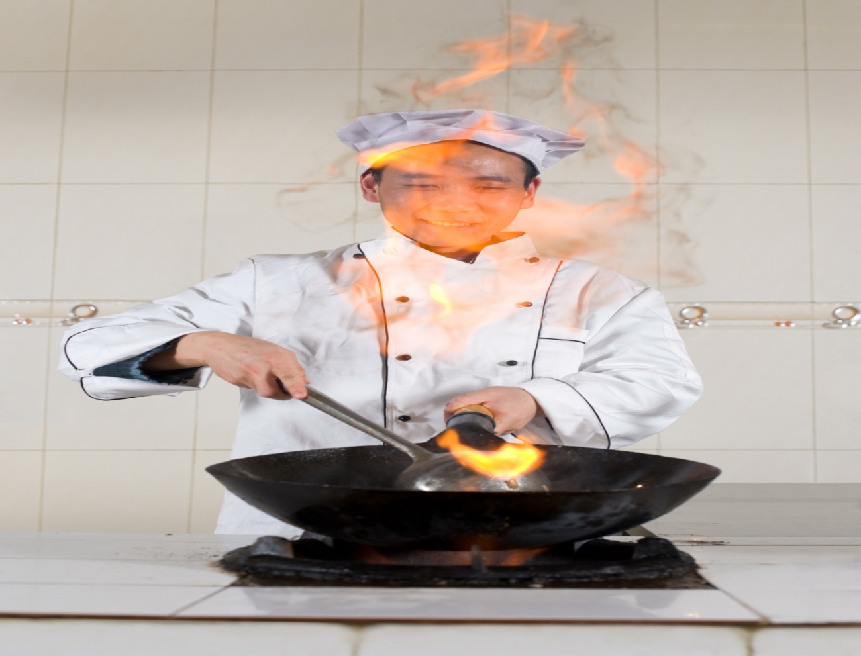
Methods of Cookery
Enabling Chefs to influence flavour, texture, nutritional value and visual enhancement.

Slide 2
Workshop Outline
Why do we cook food?
What is Heat Transference?
The effect of heat on food.
Discussing all “Methods of Cookery”
“Wet methods” and “Dry methods”
Yield effect for different Methods.
Managing Methods in Menu’s

Slide 3

Why do we cook food?
Discuss with the chefs around you, the different reasons we apply heat to food?
Notes:
To make it palatable
To minimise or kill germs (harmful bacteria)
To breakdown fibre and sinew
To extract starch.(boiling)
To develop starch (braising risotto)
To bring out natural flavours
Visual appearance
Menu variation

Slide 4
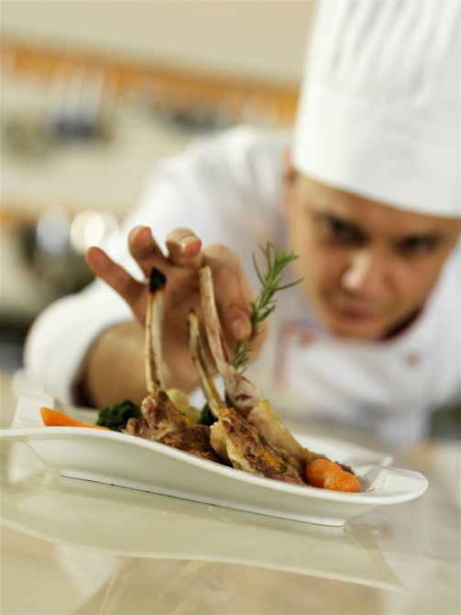
Why do we cook food?
To make it palatable
To minimise or kill germs (harmful bacteria)
To breakdown fibre and sinew (braising)
To extract starch (boiling potatoes)
To develop starch (braising risotto)
To bring out natural flavours
Visual appearance
Menu variation

Slide 5
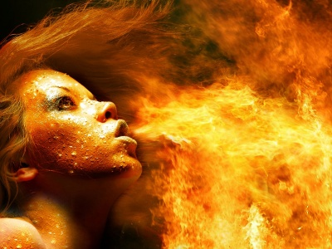
In order to cook our foods, we need a source of energy. We call it :
Heat transference

Slide 6
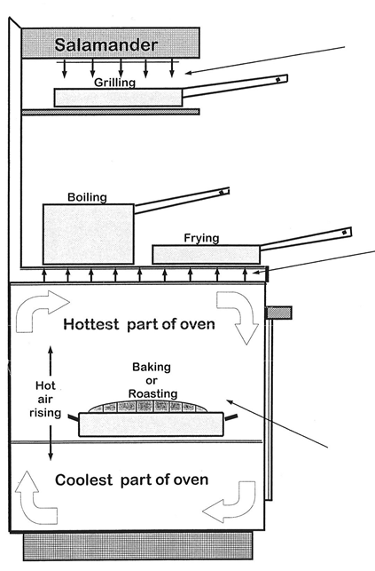
Radiation
Heat is transferred from its source directly on to the object.
Radiated
Conduction
Heat is transferred through a solid object by contact heat.
Convection
Heated water/steam air or oil etc. Penetrates the food. Food absorbs heat from the air currents convected around the oven.

Slide 7
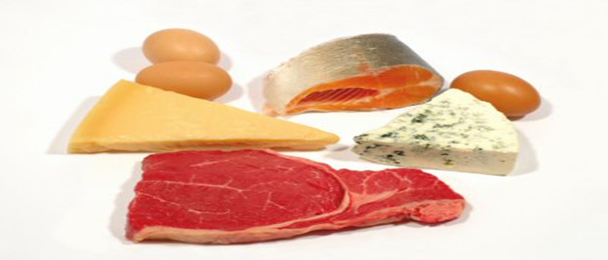
The effect of Heat on Food
Protein
Protein coagulates by heat at approx 60 degrees.

Slide 8
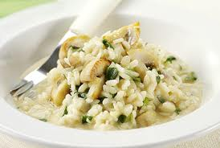
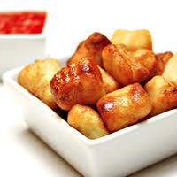
Carbohydrates
Moist heat
causes starch grains
to soften and swell
Dry heat
causes starch to change colour

Slide 9
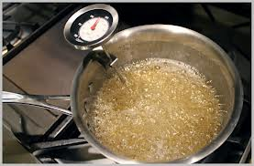
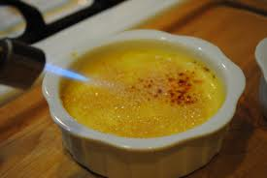
Sugars
Moist heat - cause sugars to dissolve in water and become syrup and caramelise.
Dry heat - causes sugar to caramelise quickly and burn too.

Slide 10
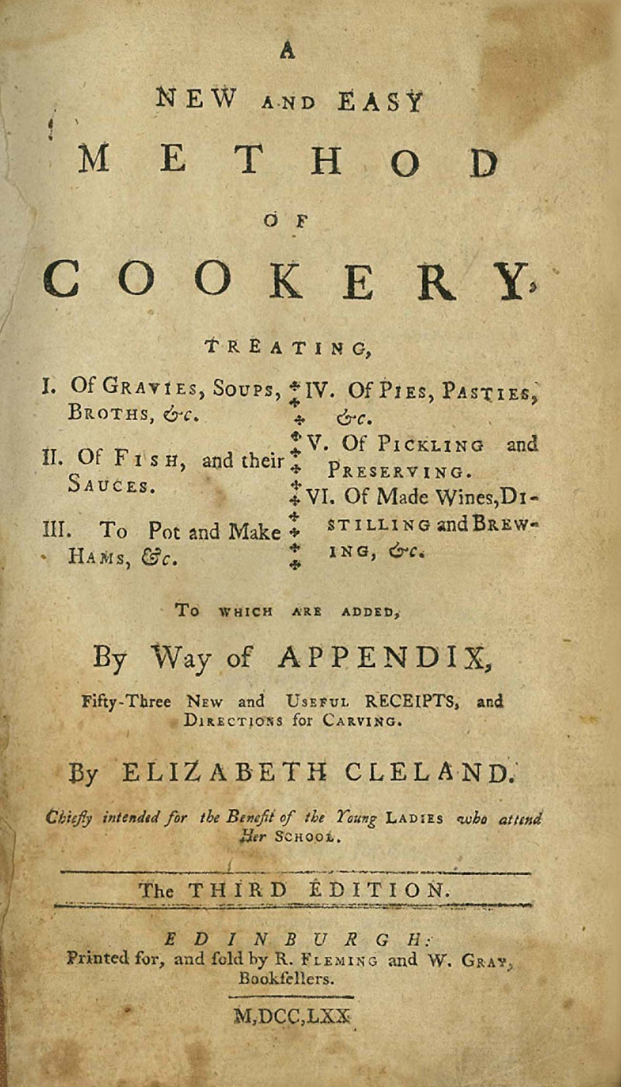
Methods of Cookery
Boiling
Steaming
Poaching
Baking
Pot roasting
Shallow frying
Deep frying
Paper bag
Micro waving
Stewing
Braising
Roasting
Grilling
Sous-vide
Tandoori
Hangi(earth oven)
Smoking

Slide 11
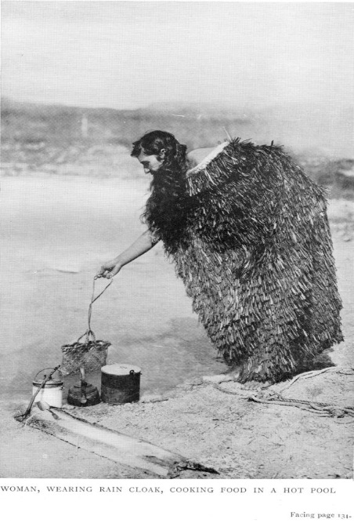
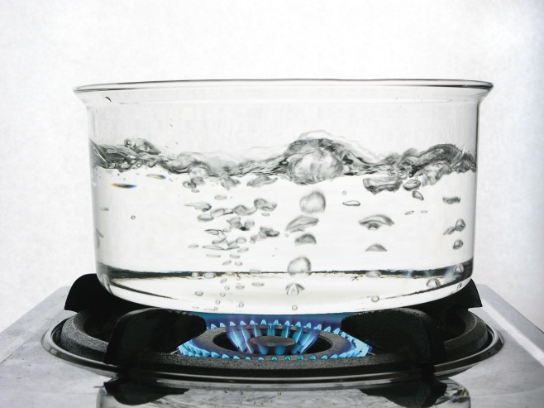
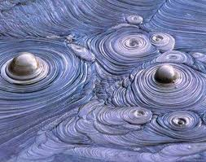
Boiling
Boiling is the cooking of prepared foods in a liquid at boiling point 100 degrees

Slide 12
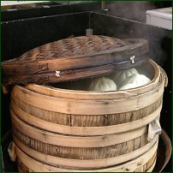
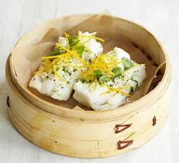
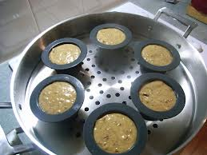
Steaming
Steaming is the cooking of prepared foods by steam (moist heat) under varying degrees of pressure.

Slide 13
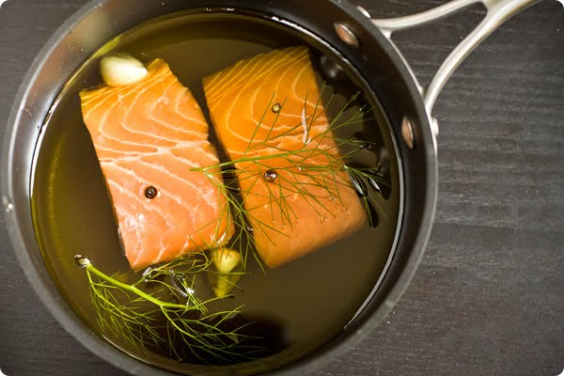
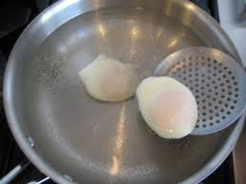
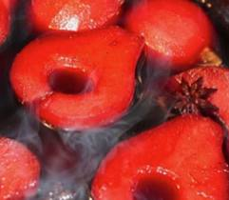
Poaching
Poaching is the cooking of food in the required amount of liquid at just below boiling point
(98ºC)

Slide 14
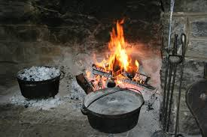
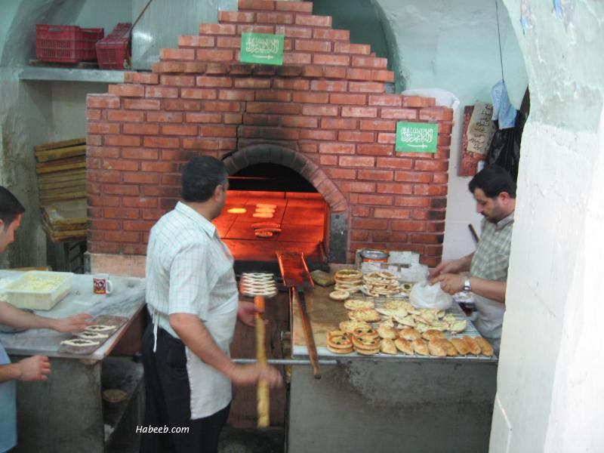
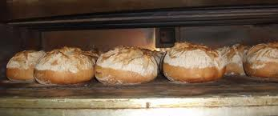
Baking
Baking is the cooking of food by dry heat in an oven
180°C – 220°C

Slide 15
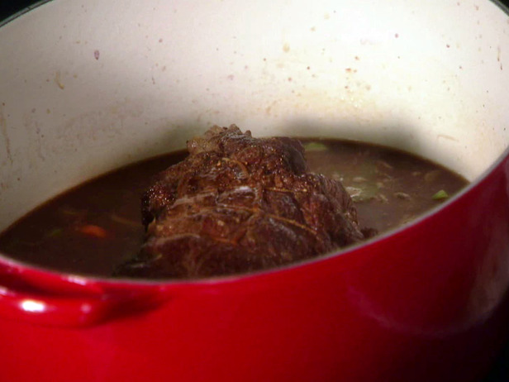
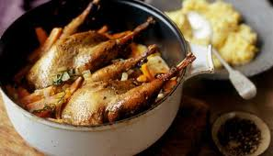
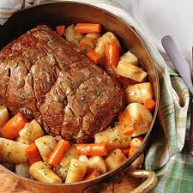
Pot roasting
Pot roasting is the cooking on a bed of root vegetables in a covered pan 150°C-160°C
Known as poêle

Slide 16
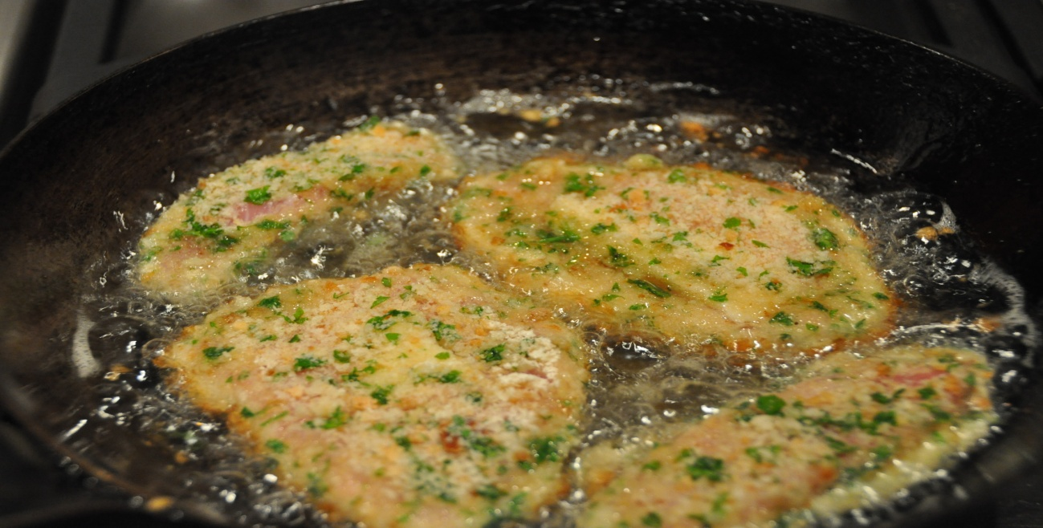
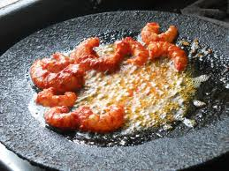
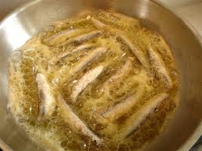
Shallow frying
Shallow frying is the cooking of food in a small quantity of pre-heated oil or fat in a shallow pan or flat surface.140°C

Slide 17
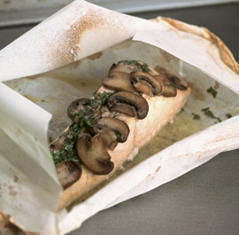
Paper bag
Known as en papillote. The food is tightly sealed in a oiled greaseproof paper bag or foil

Slide 18
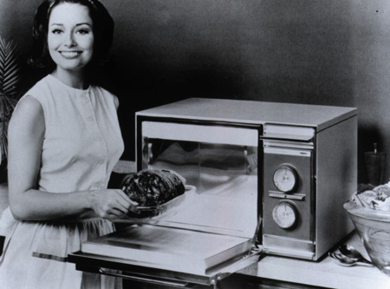
Micro wave
This is the method of cooking and re-heating food using electromagnetic waves in a microwave oven.

Slide 19
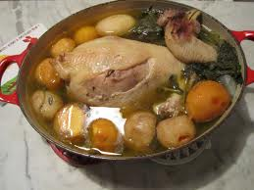
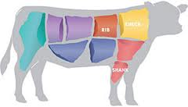
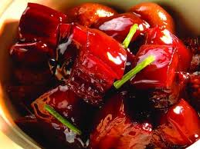
Stewing
Slow method in the oven or on the stove top
Usually lid on to prevent evaporation
Good method for using cheaper cuts or tougher meats. 140 °C - 160 °C

Slide 20
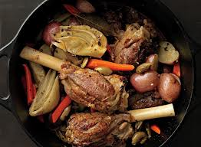
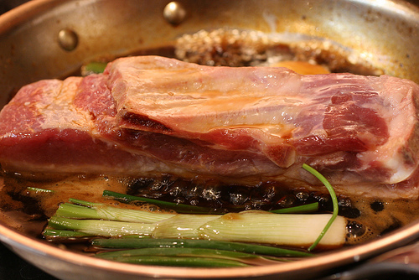
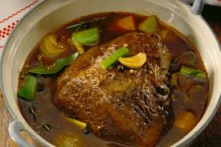
Braising
Very similar method to stewing.
Braising is the cooking of food partially covered in liquid long and slow in a vessel with a tight fitting lid.
In the oven 140 °C - 160 °C
A Suitable method for large tough cuts of meat.

Slide 21
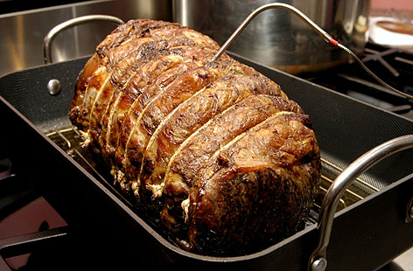
Roasting
Roasting is the cooking in a dry heat with the aid of fat or oil in an oven or on a spit. 180 to 200°C

Slide 22
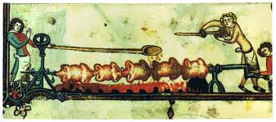
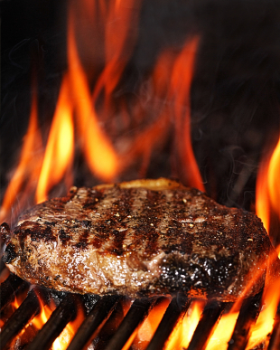
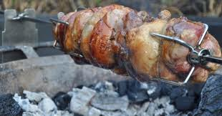
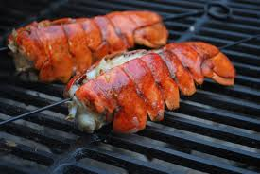
Grilling
This is a fast method of cooking under or over direct heat.

Slide 23
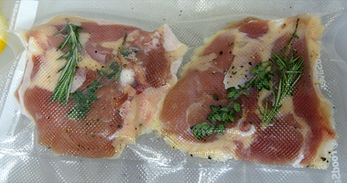
Sous-vide
(Under Vacuum)
This is a method of cookery in which raw food, with flavours and liquids are sealed in a plastic pouch and cooked in a temperature controlled water bath.

Slide 24
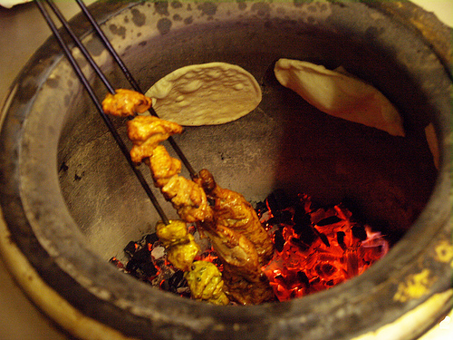
Tandoori
Cooking by dry heat in a clay oven is called a tandoori

Slide 25
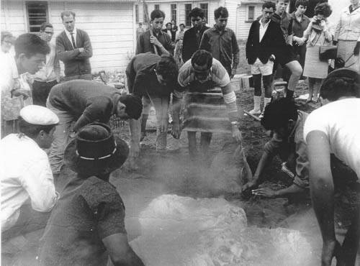
Hangi(earth oven)
Cooking of food sealed underground, using heated rocks as the source of heat by way of convection and steam by way of trap moisture

Slide 26
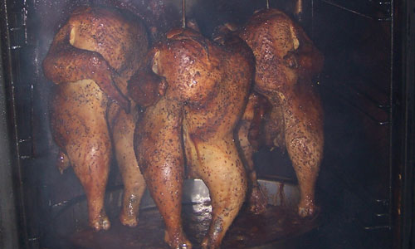
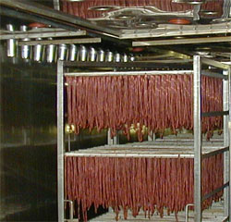
Smoking
Cooking food in a container filled with smoke
-hot smoking
-cold smoking

Slide 27
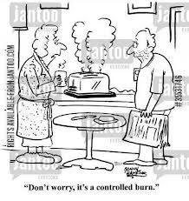
“Methods of Cookery”
“Its all about temperature control”

