Slide 1
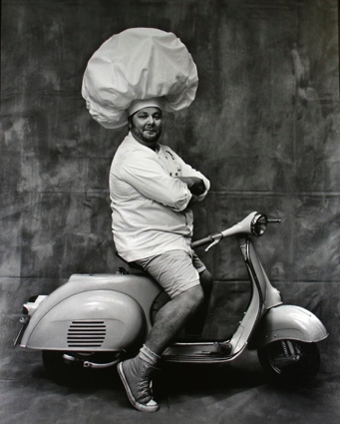
Workshop outline
Introduction
Why add a sauce?
Mother sauces
Thickening agents
Emulsion sauces
Faults
Quantity
Food safety & Storage

Slide 2
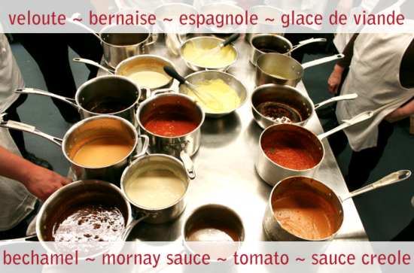
Required Knowledge
Producing good sauces demands an appreciation of flavour, an understanding of thickening methods and temperature control.

Slide 3
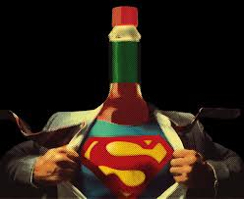
Sauces-Kinaki
Sauces are defined in taste and in texture generally a thickened liquid that is served with either sweet or savoury foods.

Slide 4
History
Many classical sauces are based upon French cookery. This is why many are known by their French name such as espagnole, jus lié, demi –glace, bechamel and velouté.

Slide 5
Discuss with the Chef next to you what a sauce brings to a meal?

Slide 6
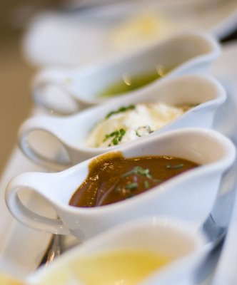
Sauces provide a meal with!
Colour
Flavour
Texture
Moisture
Coating
Contrast
Garnish
Variety
Nutrition

Slide 7
Foundation Sauces
Espagnole
Béchamel
Velouté
Tomato
Hollandaise

Slide 8
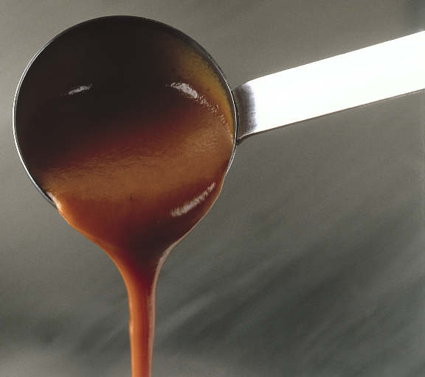
Espagnole sauce Made from brown stock and brown roux
Demi–glace is the most well known derivative of espagnole, made by mixing equal amounts of brown stock and espagnole together and reducing the mixture by 50% over gentle heat.
Demi-glace derivatives
Bordelaise – shallots, red wine, strained, meat glaze, beef marrow
Champignon – button mushrooms, white wine
Chasseur – button mushrooms, shallots, tomato concasse, tarragon, parsley
Diable – shallots, white wine, wine vinegar, strained, butter, cayenne pepper
Madere – madeira

Slide 9
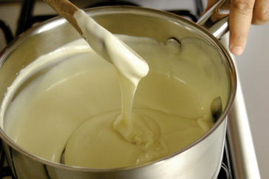
Béchamel basic white sauce
Derivatives
Mornay – cheese
Moutarde – mustard
Soubise - onion
Ecossaise-egg
Persil - parsley

Slide 10
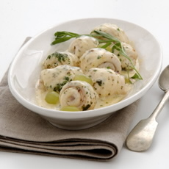
Velouté
Made from white stock and blond roux
Derivatives
Suprême– cream,lemon,mushrooms,
Aurora – tomato puree
Grenobloise – green gapes
Hongroise – onion, paprika, white wine, strained
Ivory – meat glaze

Slide 11
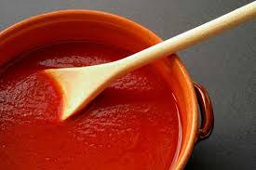
Tomato tomatoes, vegetables, oil and gastrique
Gastrique
(Reduction of vinegar and brown sugar to finish a tomato sauce)
Derivatives
Creole – onion, celery, garlic, green pepper, hot pepper sauce
Spanish – creole ingredients, button mushrooms, olives
Milanaise - button mushrooms, cooked ham, tongue

Slide 12
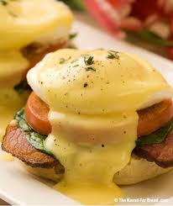
Hollandaise emulsion sauce
Made from egg yolks, warm butter, vinegar and lemon juice
Derivatives
Maltaise – blood orange
Mousseline – whipped cream
Bearnaise-Tarragon
Choron –bearnaise w tomato
Foyot –bearnaise w meat glaze

Slide 13
Common thickening agents
Roux
Cornstarch
Arrowroot
Beurre manie
Liaison
Blood
Pureeing
Reduction
Butter

Slide 14
Roux
Roux is a combination of equal parts flour and fat cooked together. Can be either white, blond or brown

Slide 15
Cornstarch
Commonly known as cornflour is derived from corn and popular in Asian cuisine for thickening sauces

Slide 16
Arrowroot
Derived from roots of a tropical plant, arrowroot has a similar texture to cornstarch but produces a clearer finished product

Slide 17
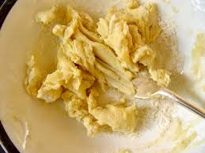
Beurre Manié
Known as kneaded butter, beurre manié is a combination of equal parts fat and flour kneaded together until smooth

Slide 18
Liaison
A mixture of egg yolk and cream added to a hot liquid at the end of the cooking process will provide it with additional richness and smoothness

Slide 19
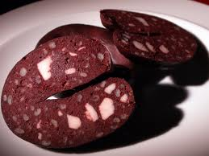
Blood
Can be used as a thickening agent, most commonly in the dishes black pudding and jugged hare

Slide 20
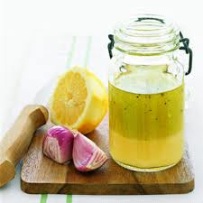
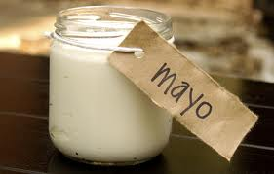
Cold Emulsion sauces In the culinary arts, an emulsion is a mixture of two liquids that would ordinarily not mix together, like oil and vinegar.
Mayonnaise
Vinaigrette
Aioli - garlic
Caesar - anchovy
Tartare – capers, gherkins, parsley
Balsamic – balsamic vinegar
Raspberry –berry vinegar
Chilli - tabasco

Slide 21
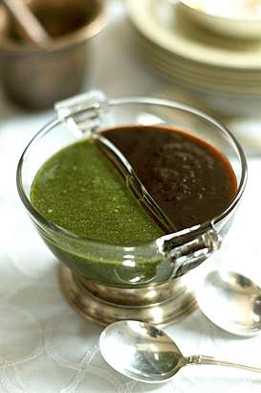
Faults! Discuss and present how these faults occur?
Lumpiness.
Poor gloss
Incorrect consistency
Greasiness
Poor colour
Curdled

Slide 22
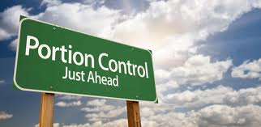
Quantity Guide
One litre serves 18-20 portions
Approximately 50mls per person

Slide 23
Food Safety & Storage
Sauce often contain ingredients which provide ideal food for bacteria.
Sauces are a high risk food
Cooled quickly
Reheat sauces 75°C (once only)
Sauces kept hot for service 65°C
Never store on high shelves
Butter sauces should not be reheated.
Sauces should be covered with wrap or a cartouche
Store in clean containers, covered and dated
Best heated in batches as needed

Slide 24
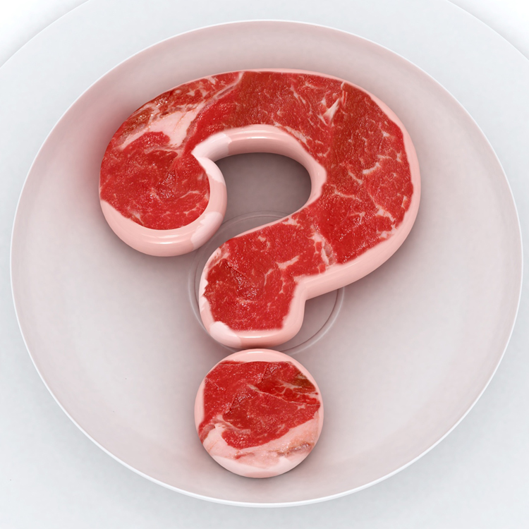
Question
What is meant by the term Correcting a Sauce?
Adjustment of consistency, seasoning, taste and temperature before service

