Slide 1

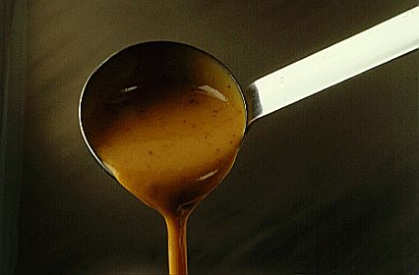

sauces
A fair description of a sauce is a well flavoured, smooth, glossy, defined in taste and light in texture thickened liquid that is served with either sweet or savoury foods. They are one of the most basic commodities in the kitchen.

Slide 2
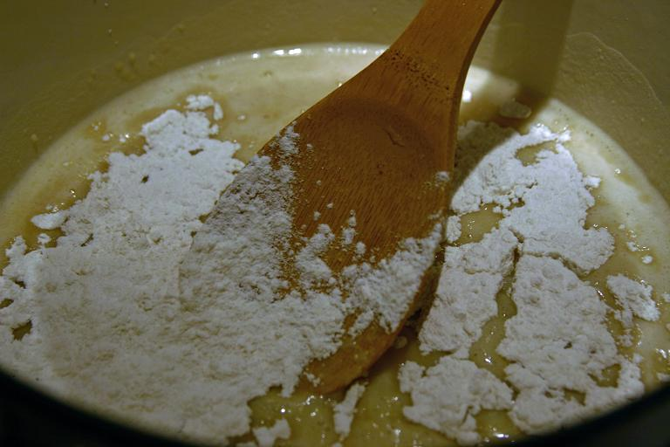
Sauces
Gelatinisation – the process of starch granules absorbing and bonding moisture when heated resulting in the thickening of a product
Dextrinisation – the process in which starch breaks down and loses its thickening properties when heated for a longer period of time

Slide 3
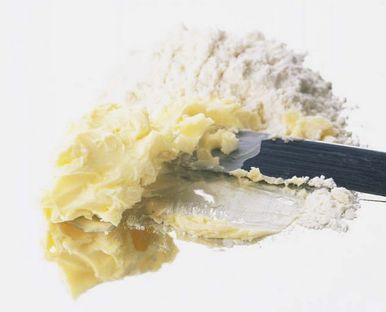
Common Thickening Agents
Roux, Cornstarch, Arrowroot, Beurre manie, Liaison
Blood, Rice

Slide 4
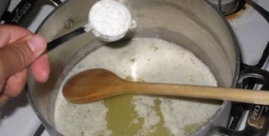
Roux
Roux is a combination of equal parts flour and fat cooked together. Can be either white, blond or brown

Slide 5
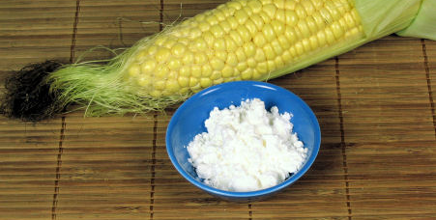
Cornstarch
Commonly known as cornflour, cornstarch it is a fine white powder that is derived from corn and popular in Asian cuisine for thickening sauces

Slide 6
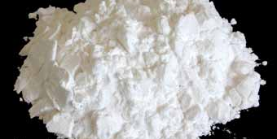
Arrowroot
Derived from roots of a tropical plant, arrowroot has a similar texture to cornstarch but produces a clearer finished product

Slide 7
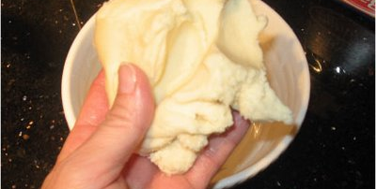
Beurre manie
Known as kneaded butter, beurre manie is a combination of equal parts fat and flour kneaded together until smooth

Slide 8
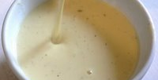
Liaison
A mixture of egg yolk and cream added to a hot liquid at the end of the cooking process will provide it with additional richness and smoothness

Slide 9
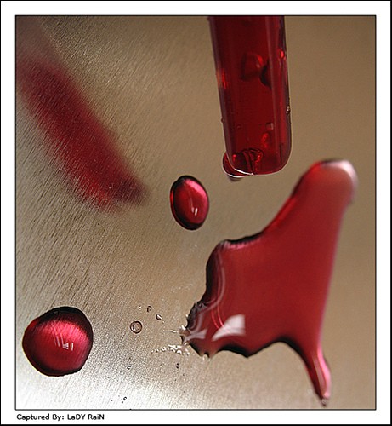
Blood
Can be used as a thickening agent, most commonly in the dishes black pudding and jugged hare

Slide 10
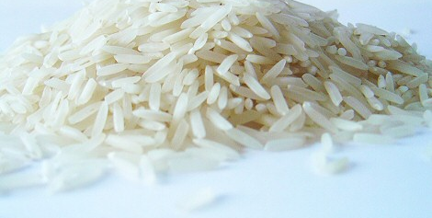
Rice
Can be used as a thickening agent, more commonly in soups as it provides a starch content to the dish

Slide 11
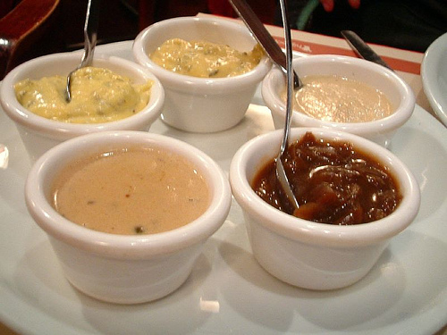
Sauces
Sauces provide a meal with
Colour
Flavour
Texture
Moisture
Coating
Contrast
Garnish
blend

Slide 12
Foundation Sauces
Foundation sauces
Bechamel
Veloute
Espagnole
Hollandaise
Tomato
What are they??

Slide 13
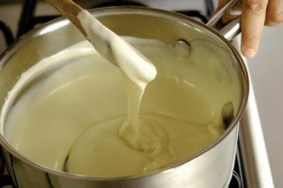
Bechamel
Made from milk and white roux
Derivatives
Mornay – cheese
Moutarde - mustard
Oeufs – hard boiled eggs
Oignon – onion
Persil - parsley

Slide 14
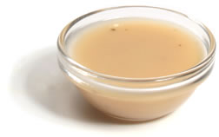
Veloute
Made from white stock and blond roux
Derivatives
Supreme – mushrooms, strained
Aurora – tomato puree
Capres - capers
Champignon – button mushrooms
Hongroise – onion, paprika, white wine, strained
Ivory – meat glaze

Slide 15
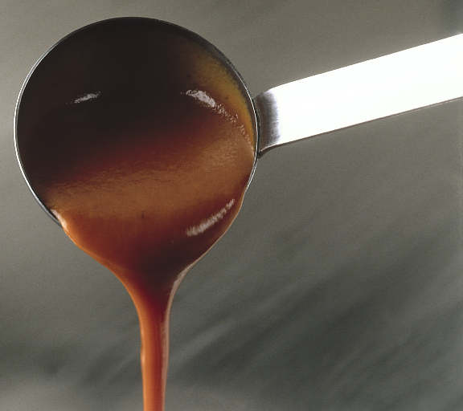
Espagnole
Made from brown stock and brown roux
Commonly turned into a demi-glace (this is referred to as a refined Espagnole)
Demi-glace derivatives
Bordelaise – shallots, red wine, strained, meat glaze, beef marrow
Champignon – button mushrooms, white wine
Chasseur – button mushrooms, shallots, tomato concasse, tarragon, parsley
Diable – shallots, white wine, wine vinegar, strained, butter, cayenne pepper
Madere – madeira

Slide 16
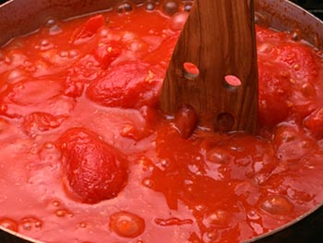
Tomato
Made from tomatoes, vegetables, oil and gastrique
Derivatives
Creole – onion, celery, garlic, green pepper, hot pepper sauce
Spanish – creole ingredients, button mushrooms, olives
Milanaise - button mushrooms, cooked ham, tongue
Gastrique
Reduction of vinegar and brown sugar to finish a tomato sauce

Slide 17
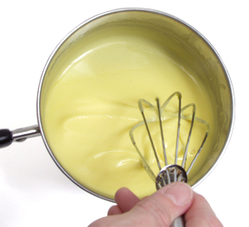
Hollandaise
Made from egg yolks, warm butter, vinegar and lemon juice
Derivatives of Hollandaise
Maltaise – blood orange
Mousseline – whipped cream
Derivatives of Bearnaise
Choron – cooked tomato concasse
Foyot – meat glaze

Slide 18
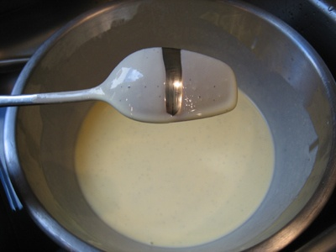
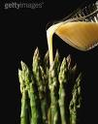
Consistency
To gage the right consistency for a sauce, we must know what we want to do with it.
A coating consistency is reached
when it coats the back of a spoon.
A pouring consistency is just that
must pour from a jug or sauce boat.

Slide 19
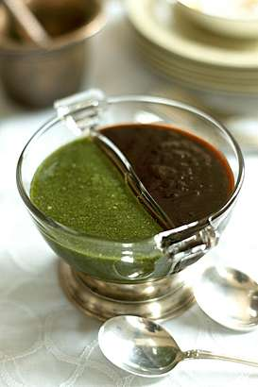
Faults
Lumpiness.
Liquid added to fast,
cold liquid added to roux,
liquid not beaten in sufficiently
Poor gloss
Over boiled not skimmed
Incorrect consistency
To much or to little thickening agent
Greasiness
Fat content to high, starch over cooked.
Poor colour
Over or undercooked ingredients
Raw starch flavour
Acid content to high , ingredients burnt
Curdled
Heat to high , fat content added too quickly.

Slide 20
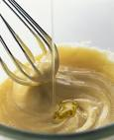
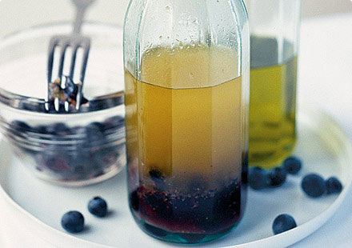
Emulsion sauces
Mayonnaise
Aioli - garlic
Caesar - anchovy
Tartare – capers, gherkins, parsley
Vinaigrette
Balsamic – balsamic vinegar
Raspberry – raspberry vinegar
Chilli - tabasco
Lemon – lemon juice
Derivatives
Derivatives

