Slide 1
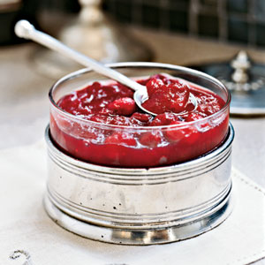
Sauces

Slide 2
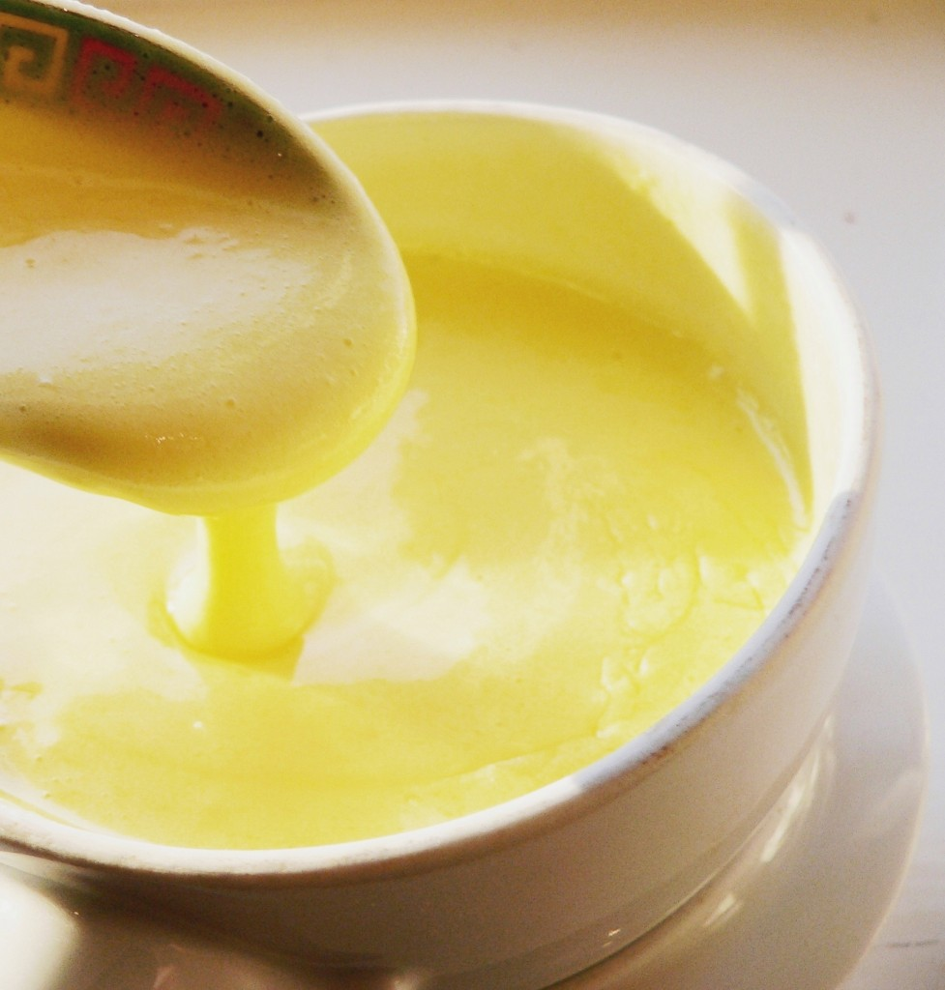
What is a Sauce?
In most cases a sauce is a thick liquid served with food, usually savory dishes, to add moistness and flavor

Slide 3
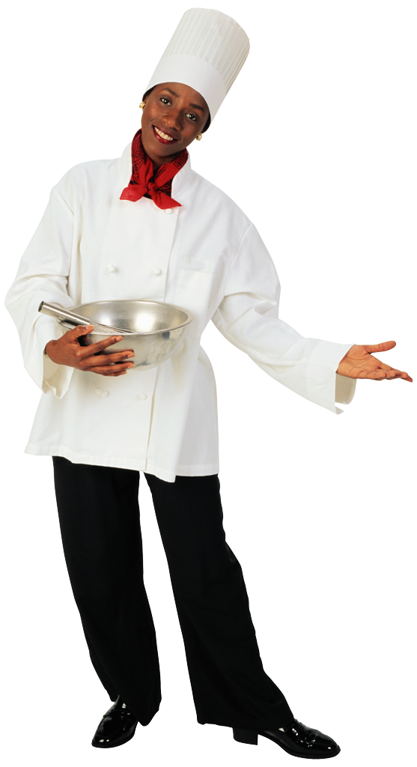
Introduction
Sauces play an important part in all areas of cookery
Enhances a dish
Provides contrasts of colour, flavour and texture

Slide 4
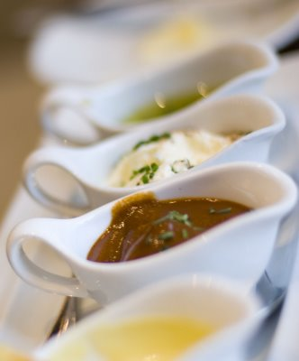
A sauce can be a liquid thickened by one or a combination of the following
Roux
Starch
Egg yolks
Cream
Beurre Manie
Butter
Pureeing
Reduction
Notes:
Roux- either white, blond or brown
Starch- such as arrowroot or corn flour diluted with liquid
Yolks- liaison with cream / emulsifying
Cream- by reducing
Beurre Manie- butter and flour mixed together (two parts butter to one part flour)
Butter- whisked in to reduced cooking liquid
Pureeing the ingredients
Reduction- evaporating

Slide 5
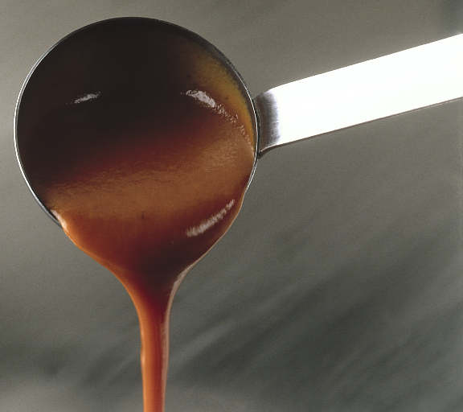
Food Safety and Storage
Sauce often contain ingredients which provide ideal food for bacteria.
Cooled quickly
Store in clean containers, Covered and dated
Refrigerated 4°C Freeze -18°C
Sauces left at room temp max 2 hours
Sauces kept hot for service 65°C
Best heated in batches as needed
Reheat sauces 75°C (once only)
Butter sauces not suitable for cooling or storage
Never store on high shelves

Slide 6
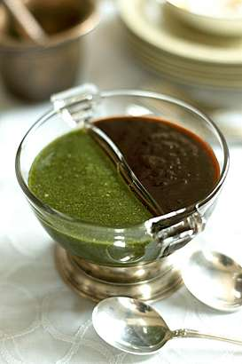
Quality Points
Quality fresh ingredients
Definite flavour
Glossy Appearance
Smoothness
Coat the back 0f a spoon

Slide 7
Quantity Guide
One litre is sufficient for 18-20 portions
Approximately 50mls per person

Slide 8
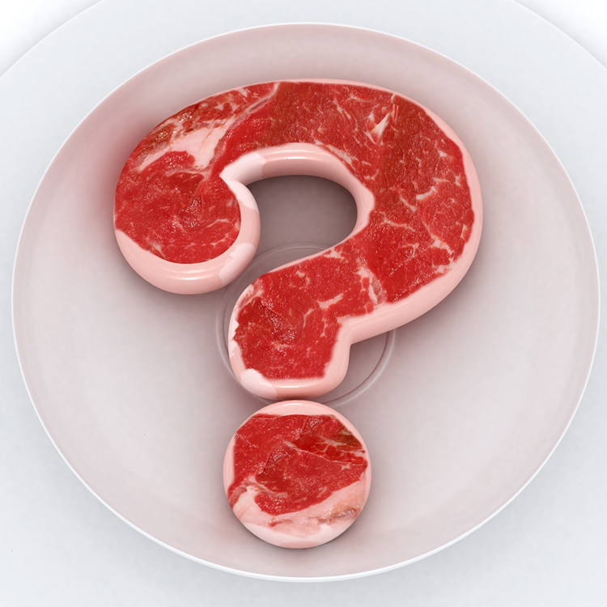
Question
What is meant by the term Correcting a Sauce?
Adjustment of consistency, seasoning, taste and temperature before service

Slide 9
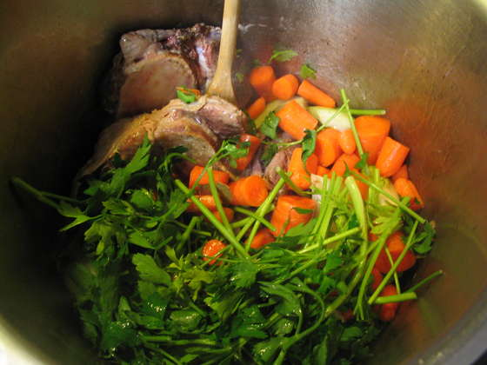
Flavour Bases
Many sauce recipes begin by sautéing a mixture of aromatic vegetables and herbs.
Cooking them first in butter or oil releases their flavours so that the sauce is infused with the flavour base.

Slide 10
Roux Based Sauces
Bechamel, Veloute and Espagnole often referred to as ‘mother’ sauces due to the many other sauces derived from them
Sauce | Bechamel | Veloute | Espagnole
Roux | White | Blonde | Brown
Liquid | Milk infused with onion cloute | White stock (Fond Blac & Fummet) | Brown beef stock

Slide 11

Homework
Find six derivative sauces for each of the three mother sauces

