Slide 1
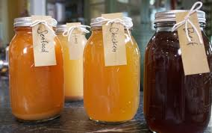
Stocks
The foundation to many great recipe's including soups, sauces and stews

Slide 2
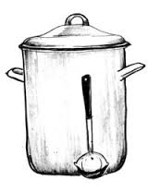
Work shop outline
Ingredients
Foundation stocks
Convenience stocks
Critical points
Faults
Questions

Slide 3
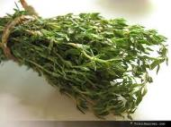
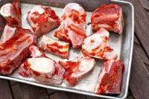
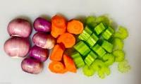
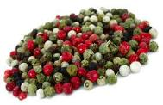
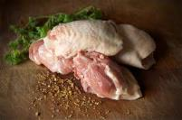

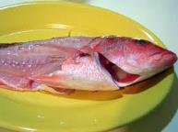

Ingredients
Fresh not frozen
Impurities removed
Not too small
Vegetables/herbs
Quality water

Slide 4



Foundation Stocks
Beef (fond de boeuf)
Chicken(fond de volaille)
Fish (fume de poisson)

Slide 5
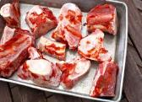

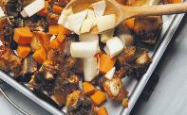
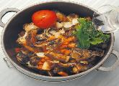
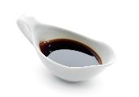
Beef Stock
Use a clean pot
Lean Marrow bones
Roast until golden
Mirepoix
Bouquet garni
2 : 1 cold water
Boil/Skim/Simmer
8 hours
Strain/boil and enjoy
Reduce

Slide 6


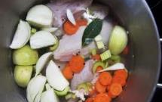
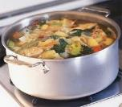
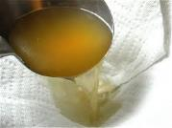
Chicken Stock
Use a clean pot
Lean chicken frames
Mirepoix
Bouquet garni
2 : 1 cold water
Boil/Skim/Simmer
4-6 hours
Strain/boil and enjoy
Reduce for glaze

Slide 7
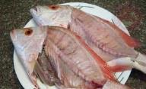
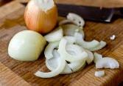
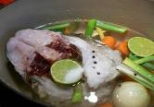


Fish stock
Use a clean pot
Butter
Onions
Clean fish frames
Bouquet garni
2 : 1 cold water
Boil/Skim/Simmer
20 minutes
Strain/boil and enjoy
Reduce for glaze

Slide 8
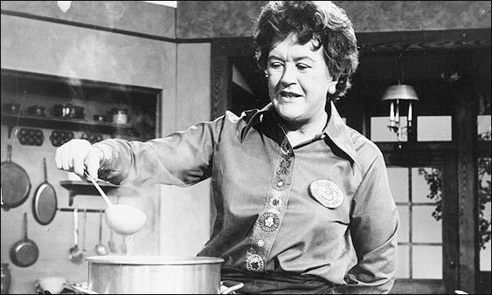
What other stocks could you make?

Slide 9
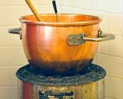
Lamb
Vegetable
Pork
Dashi
Venison
Crustacean

Slide 10
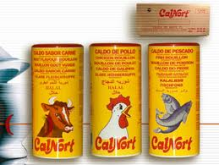
Convenience Stocks
Discuss the pro’s and cons of convenience stocks.

Slide 11
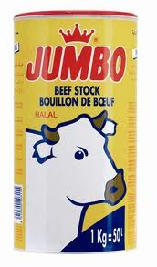
Pro’s and Cons
FOR
Low Cost
Fast
Consistent
Shelf life
Low risk
Accessible
User friendly
AGAINST
High in sodium
MSG
Un-natural flavour
No gelatinous quality
Overpowering
Shows no skill
Cowboys use it.

Slide 12
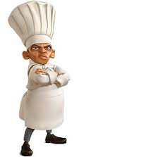
What went wrong Chef?
Greasy
Sour
Cloudy
Incorrect colour
Bitter
Uneven flavour profile

Slide 13
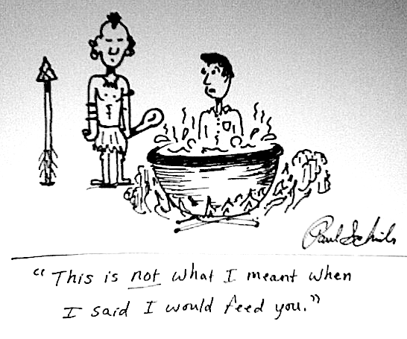
Questions

