Slide 1
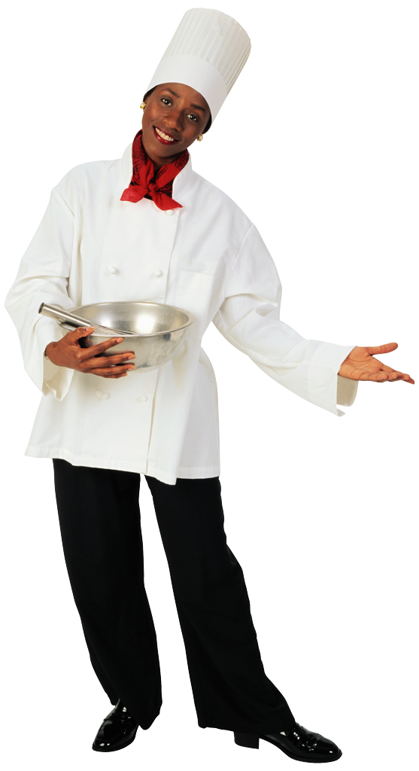
Soups - Hupa
An Introduction to…..

Slide 2
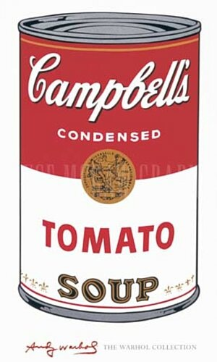
What is Soup?
A liquid dish, typically made by boiling meat, fish, or vegetables, etc., in stock or water
Can be served hot or cold
Derives from the word “sop”
Limited only by the chefs imagination
First eating establishment (restaurant) opened in Paris 1765 and served only soups

Slide 3

Introduction
Served as a first course
Lunch dish or meal
Should be light & delicate
Stimulate the appetite
200-250mls
Likely to be thick and filling
Larger portions
Served with bread

Slide 4
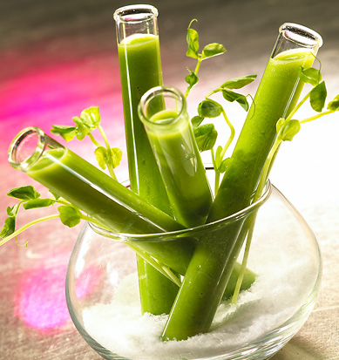
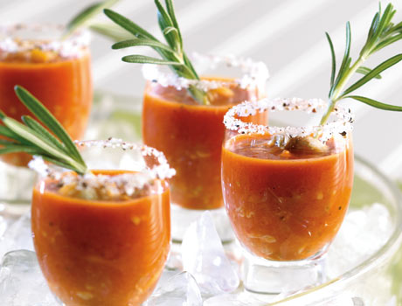
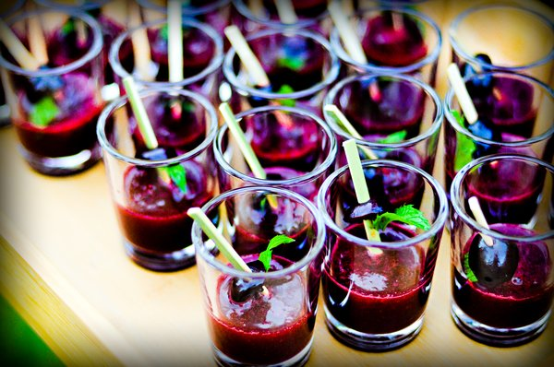
Introduction
Cocktail Functions
Served along side canapés
Served in shot glasses, demitasse cups or even test tubes

Slide 5
Classification of Soups
Thickened | Un-thickened
Puree | Broth
Cream | Consommé
Bisque
Chowder
Veloute
Brown Soups

Slide 6
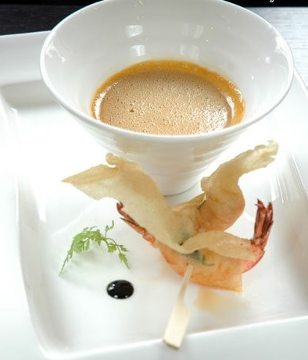
Bisque
Soup containing crustaceans, traditionally thickened with rice

Slide 7
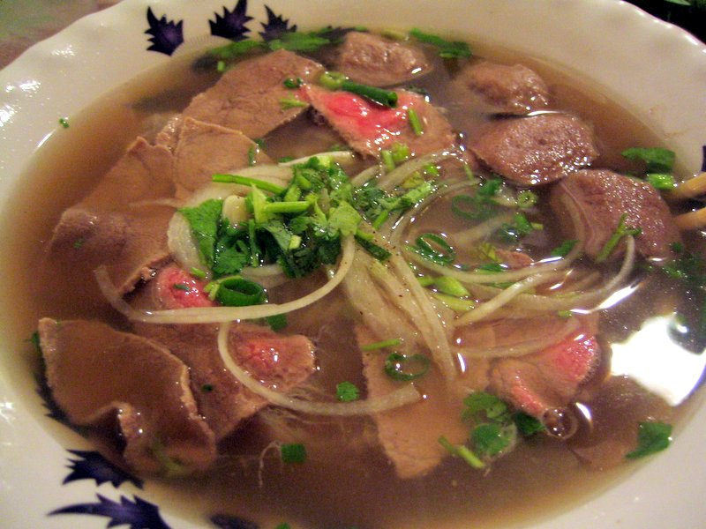
Broth
Well flavoured stock containing diced ingredients

Slide 8
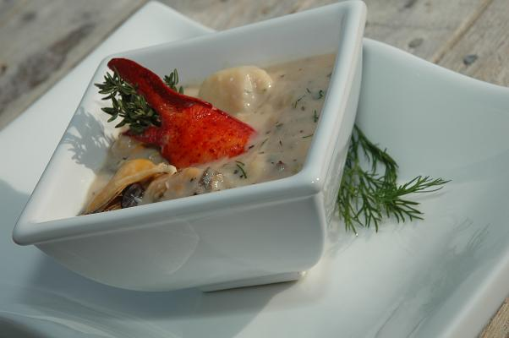
Chowder
Thick creamy soup containing chunky ingredients

Slide 9
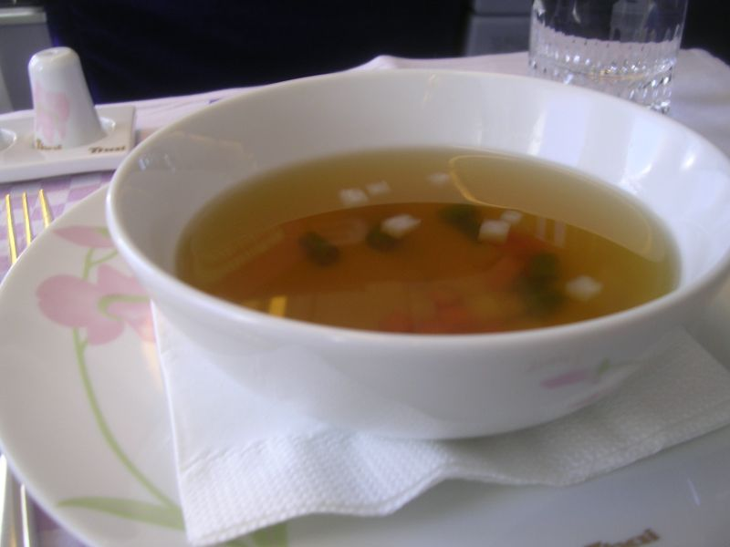
Consomme
Clarified soup made from well flavoured stock

Slide 10
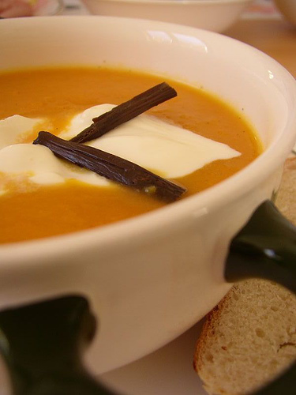
Cream Soup
Puree, veloute, or bechamel based soup containing cream

Slide 11
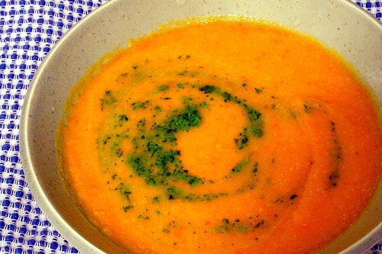
Puree
Thickened by blending its main ingredients

Slide 12
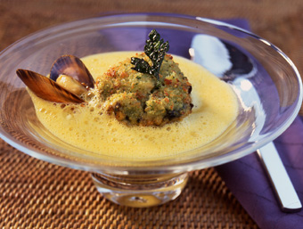
Veloutes
Roux based soup, flavoured stock with the addition of vegetables, meat or fish
Finished with a liaison

Slide 13
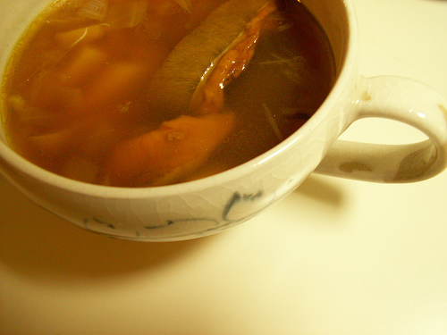
Brown Soups
Roux based soups diluted with stock with the addition of vegetables and meat.

Slide 14
Storage & Food Safety
Soups contain stocks, cereals and other protein foods, ideal for bacteria, therefore safe food handling is essential.
Max 2hrs at room temp
Held above 65°C (75°C preferable)
Cooled quickly
Covered & Dated
Refrigerated 4°C
Stored 1-3 Days @ 4°C
Freezer 1 month
Best re-heated to 100°C
Taste with clean spoon

Slide 15
Nutrition.
Soups can be very nutritious.
The amount of healthy nutrients depends on…
The type of ingredients – vegetables, pulses, lean meats and quality stocks are high in proteins and vitamins
The quality of ingredients – fresh is best
The length of cooking time
The temperatures used

Slide 16
Cooking and Serving Tips
Simmer
Good quality fresh ingredients, firm, clean and free from blemishes
Quality stock
Use finest chinois
Boil soup to order
Check seasoning before serving
Check consistency before serving
Serve hot soup hot, cold soup cold

Slide 17
Cooking and Serving Tips
Sweat the aromatics
Use herbs sparingly
Hit it with freshness
  Fresh herbs
  Citrus juice
  Dollop of cream or yoghurt
Use garnishes that compliment the soup
  Go beyond chopped parsley
  Soup garnishes should offer a contrasting flavour or texture
  Crunchy on smooth
  Smooth on chunky
  Salty on sweet

Slide 18
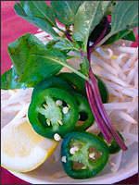
GARNISHES
Without exception should be small, neat, dainty & appropriate!
Simple Vegetable shapes
Small patties
Raviolis
Quenelles
Cooked meats
Cheese
Cheese straws
Pasta & Cereals
Chiffonades
Croutes & Croutons
Pancakes
Profiteroles
Pluches

Slide 19
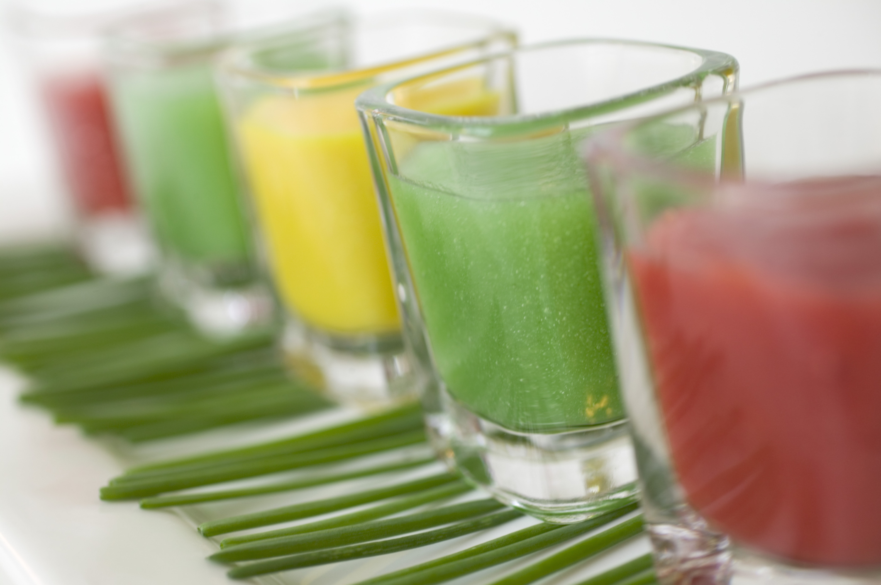

Slide 20
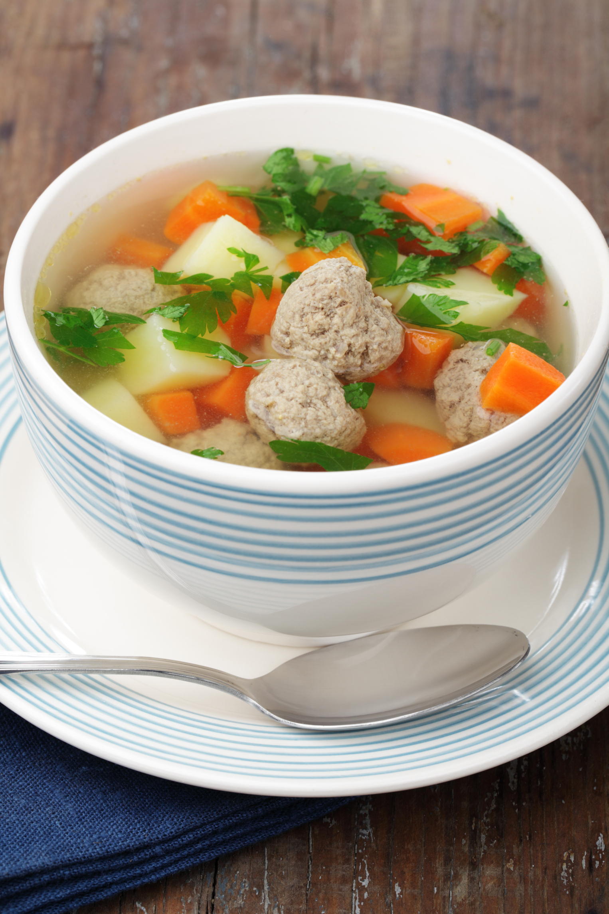
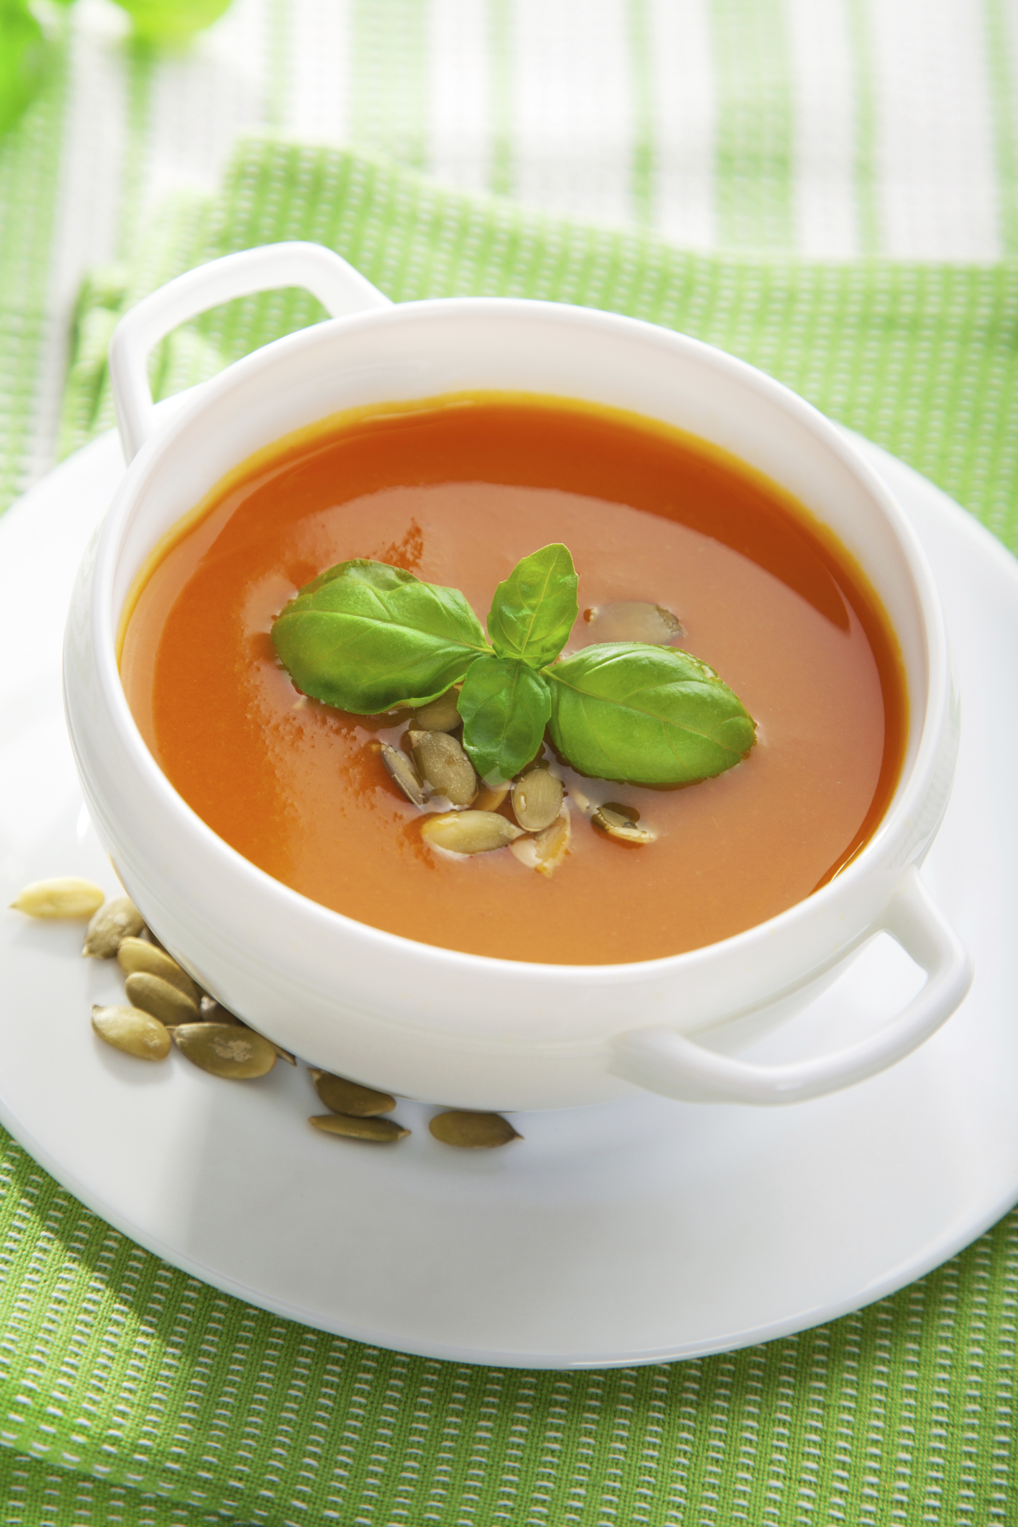

Slide 21
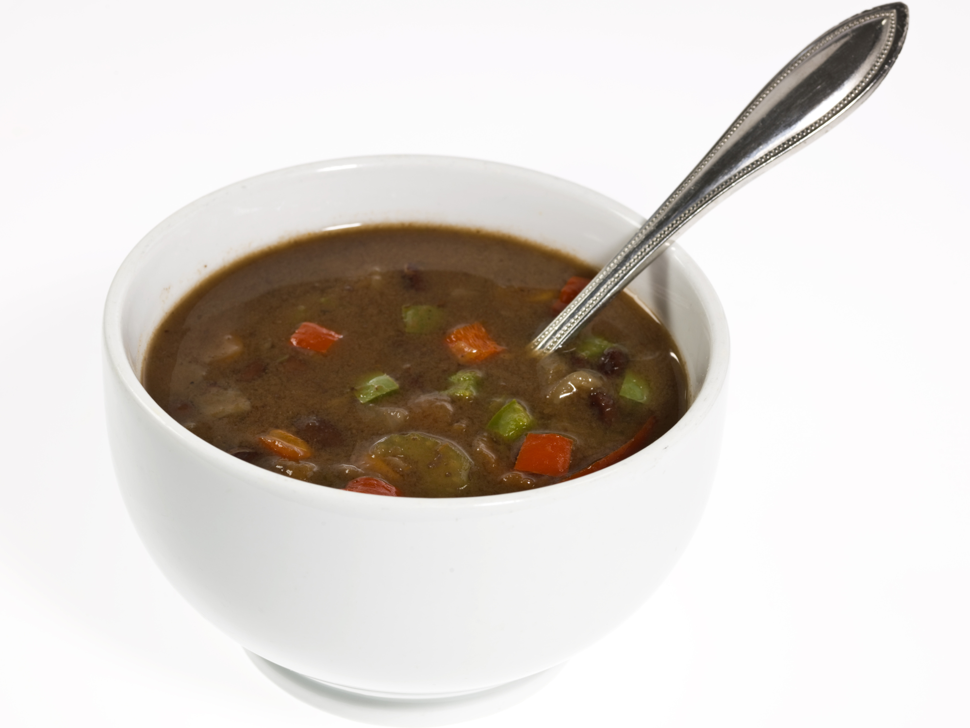

Slide 22
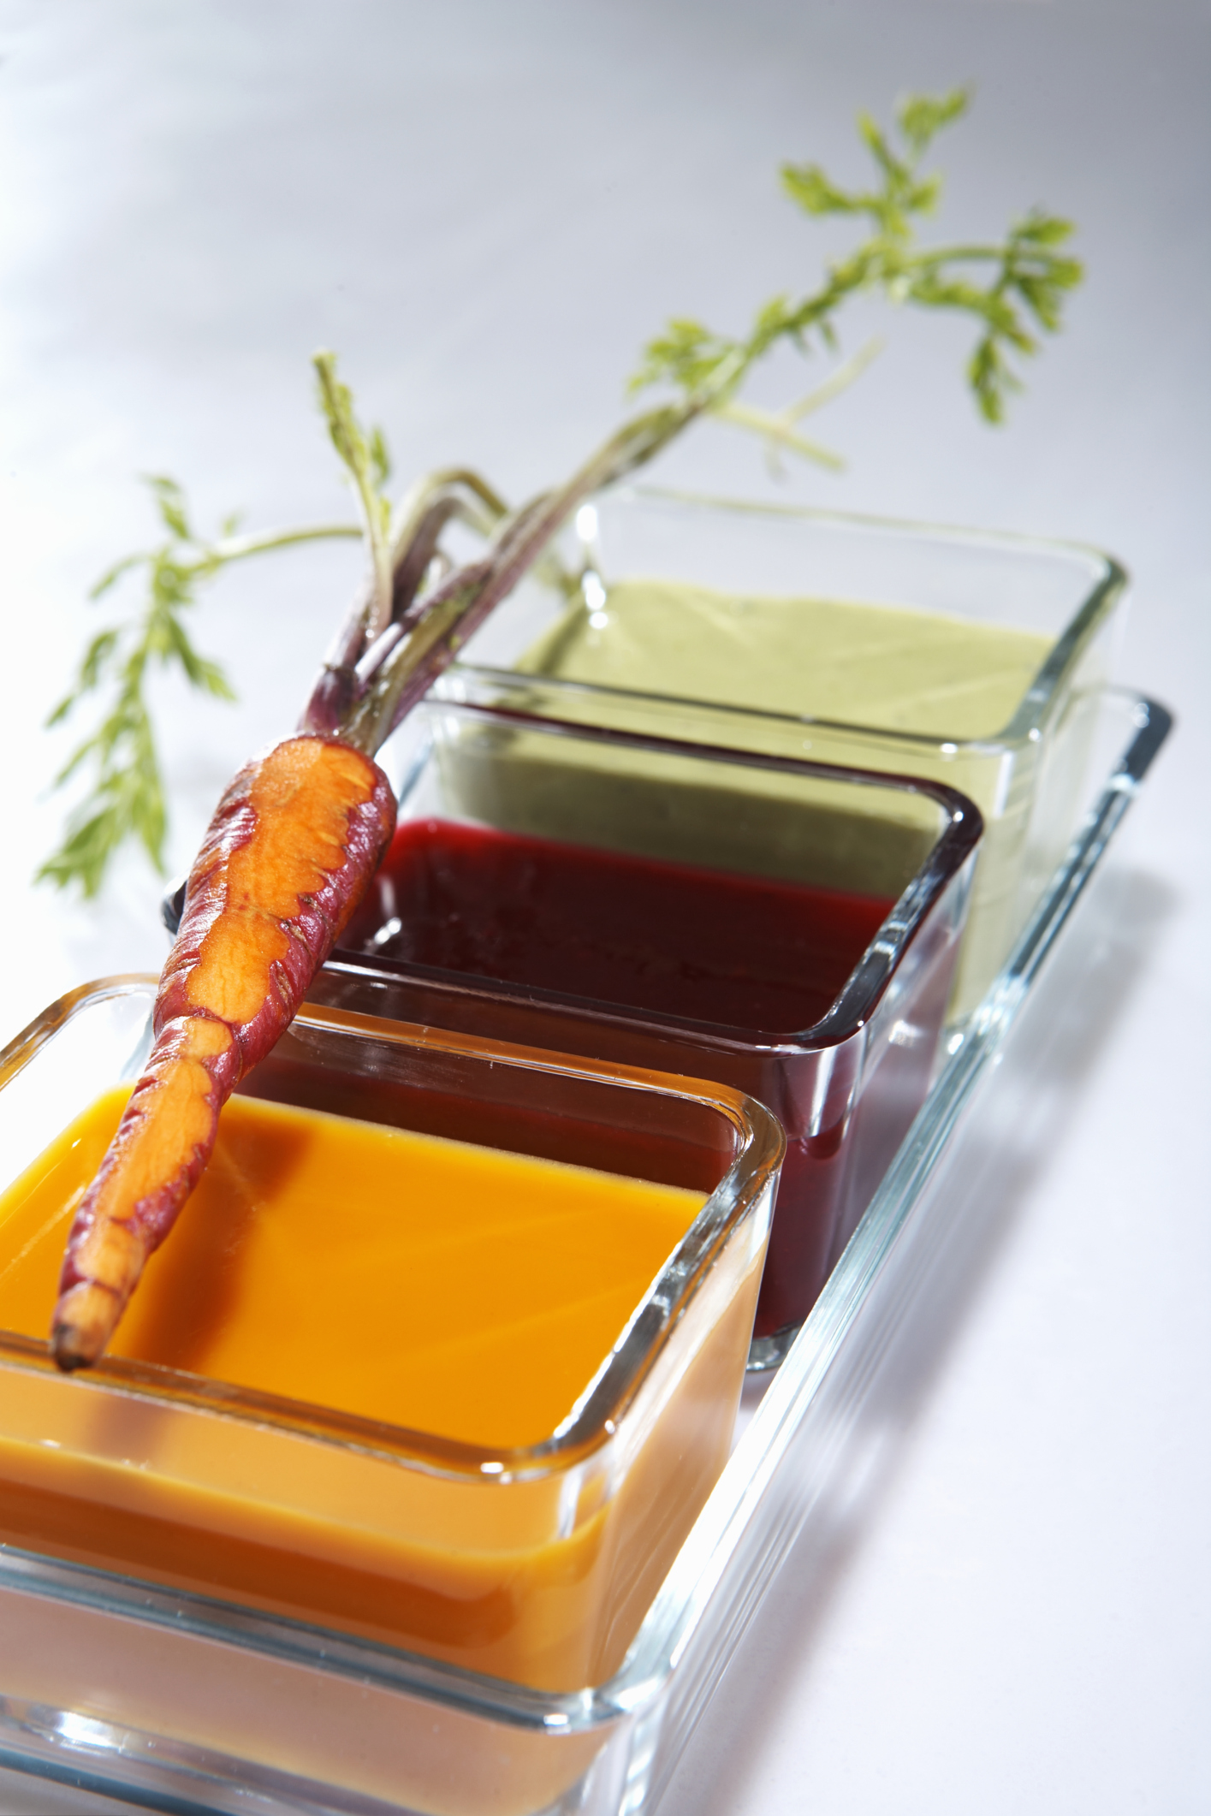


Slide 23
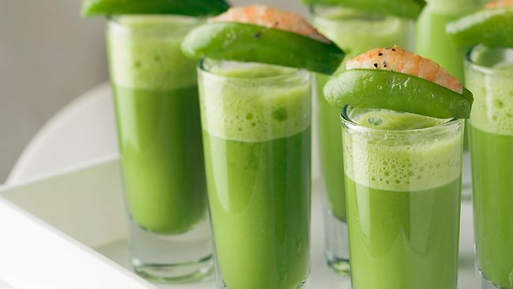

Slide 24
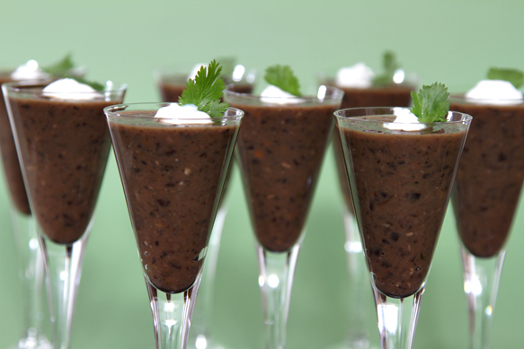
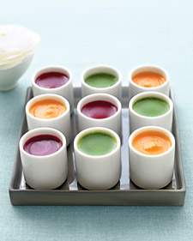
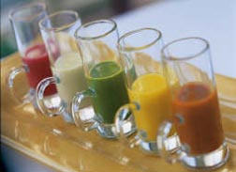

Slide 25
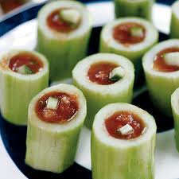
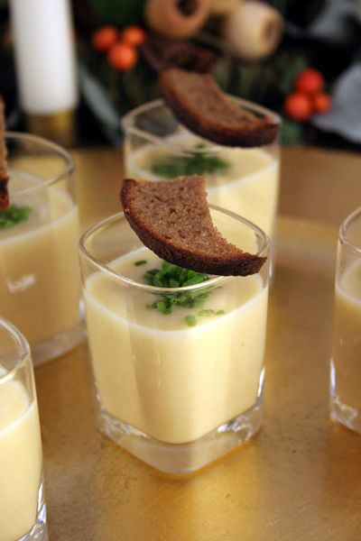
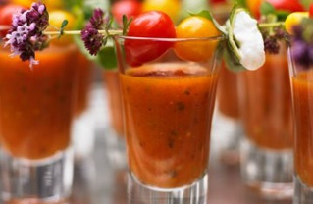

Slide 26


