Slide 1

Which do you prefer?

Slide 2
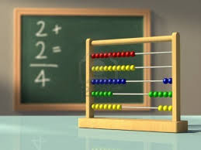
Workshop Outline
Introduction
Understanding Costs
Individual Costing
Recipe Costing
GST
Mark up/downs
Ratio’s
Currency conversion

Slide 3
How much should we charge?
To set the selling price of any product
We must first know……..
*Material cost
*Labour cost
*Overheads
*Net profit

Slide 4
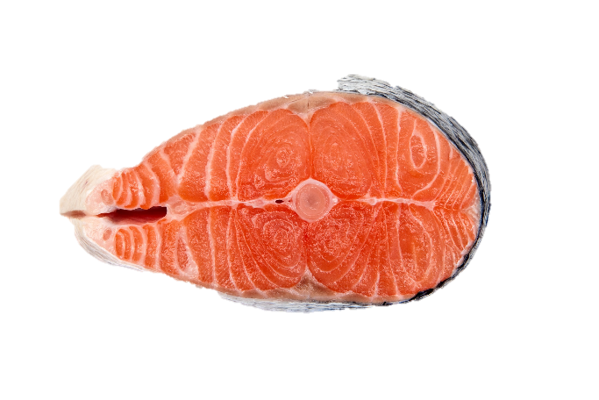
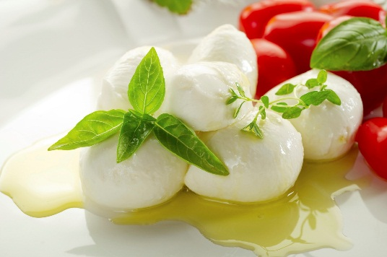
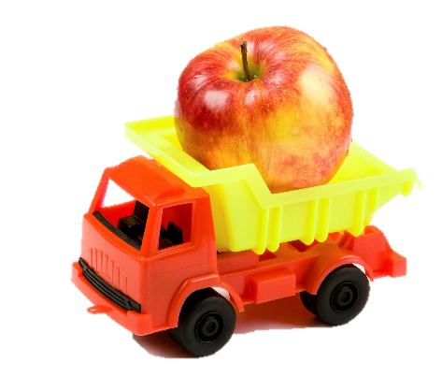
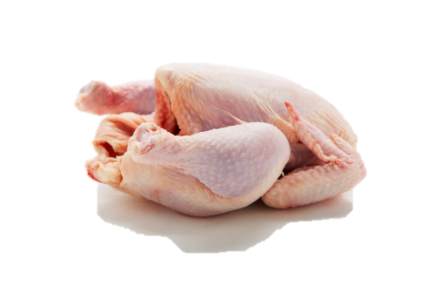
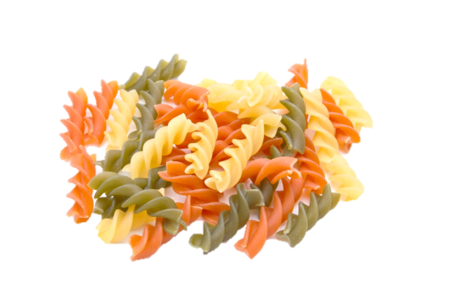
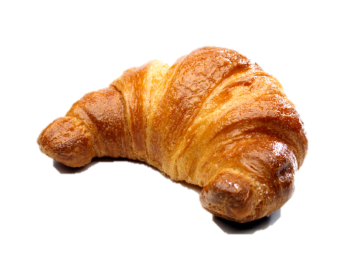
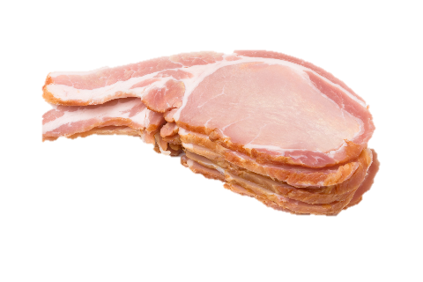
Material cost
(food items)

Slide 5
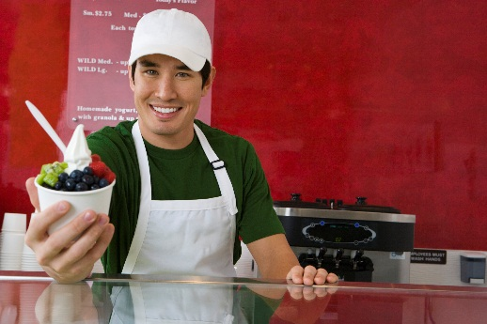
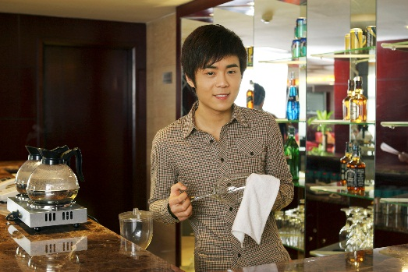

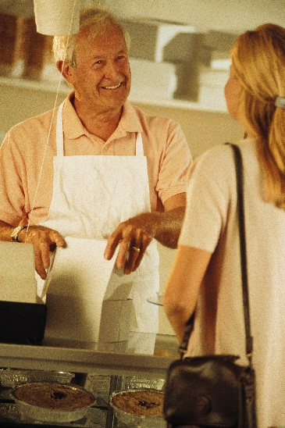
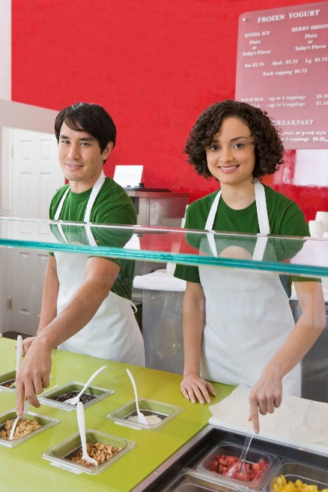
Labour cost
(Cost of staff)

Slide 6
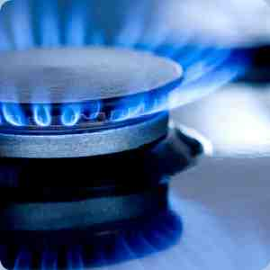




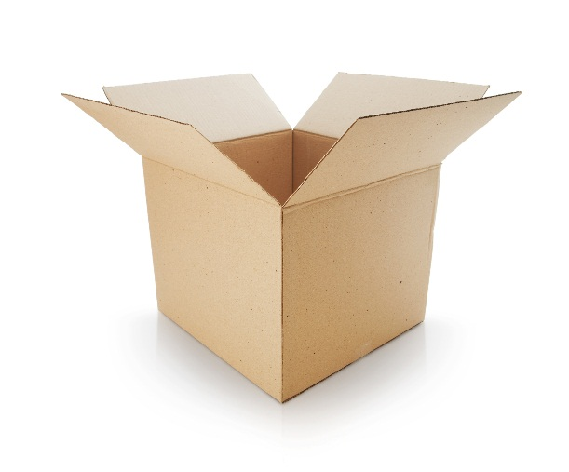
Overhead cost
(operational expenses)

Slide 7
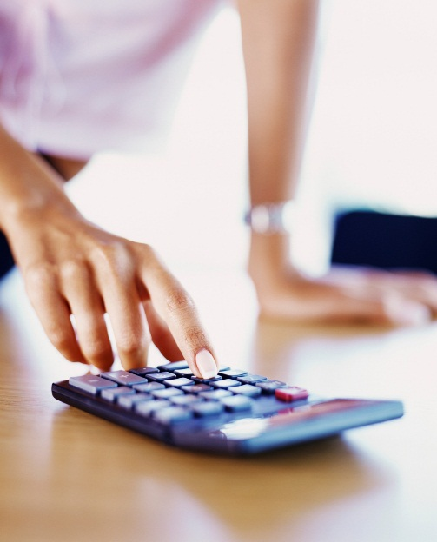
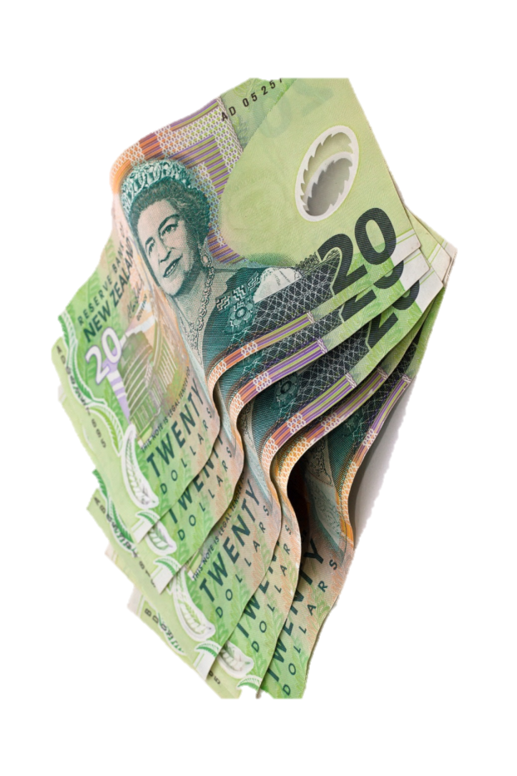
Net profit
(the amount left after all materials ,labour and over heads are paid)

Slide 8
Gross profit
(also known as a margin/mark up)
Gross profit is the amount that is
left after only the food cost has been taken out !

Slide 9
Example
Chicken dish sold for $3.50
Take away food cost $1.20
= gross profit $2.30

Slide 10

Gross profit Percentage
Executive chefs are asked to work to specific financial margins, these can include working to Gross Profit Margins
So how does this work????
We need to know 2 things
Food Cost
Gross Profit % required
Example
Your chicken salad costs $5.30 in raw materials (FC) your manager has asked what the selling price will be for the new summer menu, based on a 70% Gross Profit Margin
$5.30 (fc) ÷ 30 (fc %) x 100 = $17.666 (rounded up $17.70 selling price)

Slide 11
So let’s calculate a few scenario’s
Item | Food Cost | GP Margin | Selling Price (SP)
Ham Sammy | $ 1.57 | 65% | ?
Beef Salad | $4.80 | 75% | ?
Muffin | .73 cents | 60% | ?
Pie | $1.46 | 65% | ?
Fish & Chips | $6.24 | 70% | ?
Burger | $4.50 | 50% | ?
Breads & Dips | $2.90 | 70% | ?
*Remember FC ÷ (100-GP Margin) x100 = SP

Slide 12
So how did you do?
Item | Food Cost | GP Margin | Selling Price (SP)
Ham Sammy | $ 1.57 | 65% | $ 4.50
Beef Salad | $4.80 | 75% | $ 19.20
Muffin | .73 cents | 60% | $ 1.80
Pie | $1.46 | 65% | $ 4.20
Fish & Chips | $6.24 | 70% | $20.80
Burger | $4.50 | 50% | $ 9.00
Breads & Dips | $2.90 | 70% | $ 9.70
*Remember FC ÷ (100-GP Margin) x100 = SP

Slide 13
Calculating the selling price
Food cost ÷ food cost% x 100 =selling price(100%)
I.e. pasta food cost($1.50)÷food cost % (30%) x 100 = selling price.($5.00)

Slide 14
Do some examples
Don’t forget
Food cost ÷ food cost % X 100 = selling price
Item food cost food cost% selling price salad $7.80 40% =
Steak $4.80 32% =
Pasta $3.20 25% =
Soup $0.90 15% =

Slide 15
Answers
Item food cost food cost% selling price salad $7.80 40% = $19.50
Steak $4.80 32% = $15.00
Pasta $3.20 25% = $12.80
Soup $0.90 15% = $6.00

Slide 16
How to work out the cost of a dish
(food cost)
We need to find out how much product we are using ,then the price of that amount!

Slide 17
Example
Need 45mls of olive oil @ $15.00 a litre
SO
$15.00÷1000=0.015(cost of 1 ml) x 45 =$0.675 for 45mls

Slide 18
Example
Need 125gms butter @$11.58 kg
SO
$11.58÷1ooo=0.01158 (cost of 1 gram) x 125=$1.44 for 125 gm

Slide 19
Example
115mls maple syrup @$35.86 for 1.8 litres
SO
$35.86÷1800=0.0199 (cost of 1 ml) x115=$2.29 for 115 mls

Slide 20
2 kg Sweet pastry
Cost each item then calculate total cost of recipe
Flour 1kg @ $0.80kg
Butter 600gms @ $3.50 kg
Sugar 200gms @ $0.90 kg
Eggs 4 @ $1.80 doz
B/powder 10gms @ $3.00 kg
Salt 10gms @ $0.75 kg
Total cost =

Slide 21
2 kg Sweet pastry
Flour 1kg @ $0.80kg =$0.80
Butter 600gms @ $3.50 kg=$2.10
Sugar 200gms @ $0.90 kg=$0.18
Eggs 4 @ $1.80 doz=$0.60
B/powder 10gms @ $3.00 kg=$0.03
Salt 10gms @ $0.75 kg=$0.0075
Total cost $3.7175
So how much for 100 gm of pastry?

Slide 22

Calculation / 3.7175 ÷ 2000 = cost of 1 gram x 200 =
$0.185

Slide 23
So with this information work out this beef dish
This recipe make 50 portions
Steak 7.5 kg @$6.00 kg
Carrot 2kg @$1.20kg
Onion 2kg @$0.80kg
Flour 400gm @$0.80kg
Stock 10 litres @ $0.40 lt
Oil 400mls @$1.80 lt
Tomato paste 500g@$1.50kg
Total Cost (50 Portions)=

Slide 24
Steak 7.5 kg @$6.00 kg=$45.00
Carrot 2kg @$1.20kg=$2.40
Onion 2kg @$0.80kg=$1.60
Flour 400gm @$0.80kg=$0.32
Stock 10 litres @ $0.40 lt=$4.00
Oil 400mls @$1.80 lt=$0.72
Tomato paste@$1.50kg=0.75
Total cost 54.79per 50 portions
SO…………..

Slide 25

What we can now do with all this information
How much is 1 portion???
What is the selling price if we have a 25% food cost???
What is the selling price if we have a 60 % gross profit????

Slide 26
How much is 1 portion???
$54.79 ÷ 50 = $1.0958($1.10)
What is the selling price if we have a 25% food cost???
$1.10 ÷ 25 x 100 = $4.40
What is the selling price if we have a 60 % gross profit????
$1.10 ÷ 40 x 100 = $2.75

Slide 27
G.S.T
Goods and services tax
(the governments cut)
G.S.T is set at 15%
We need to add G.S.T to any product that we sell!!!
The selling price before G.S.T is added=100%
The selling price after G.S.T is added= 115%
How do we do this?

Slide 28
HOW TO WORK IT OUT
$ 7.00 ÷ 100 x 115 = $8.05 to add G.S.T
$ 8.05 ÷ 115 x 100 = $7.00 to take away G.S.T

Slide 29
Examples
$ 7.00 ÷ 100 x 115 = $8.05 to add G.S.T
$ 8.05 ÷ 115 x 100 = $7.00 to take away G.S.T
Add G.S.T to these
Soup $8.80
Pate $14.00
Pizza $ 5.60
Fish pie $4.50
=$10.12
=$16.10
=$6.44
=$5.17

Slide 30
Example
$ 7.00 ÷ 100 x 115 = $8.05 to add G.S.T
$ 8.05 ÷ 115 x 100 = $7.00 to take away G.S.T
Take G.S.T away
Burger $15.50
Pasta $23.00
Fish and chips $ 16.89
Steak $34.00
=$13.47
=$20.00
=$14.68
=$29.56

Slide 31
Mark-ups
A mark up/mark down is the amount as a % that you wish to make on a product that you are selling. or take off a product.
I.e.… oyster cost $8.50 you would like a 25% mark up so..
$8.50 ÷ 100 x 25 = $2.12 + $8.50 = $ 10.63
Add a 50% mark up
$8.50 ÷ 100 x 50 = $4.25 +$ 8.50 = $12.75

Slide 32
Mark down
Works in reserves
25% mark down on oysters
$8.50 ÷ 100 x 25 = $2.12. $8.50 -$2.12 = $6.37
50% mark down
$8.50 ÷ 5o = $4.25 . $8.50-$4.25 = $4.25

Slide 33
Examples
Mushrooms $8.90, 75% mark up
Bottle of wine $24.00, 150% mark up
pasta dish $18.45, 25% mark down
Fresh fish $7.90, 36% mark down
$15.58
$60.00
$13.84
$5.06

Slide 34
Ratios
=1:2
= 3:1
3 parts flour
2 parts butter
1 part sugar

Slide 35
Work these out
3:1
5:1
2:1

Slide 36
Currency rates conversion
To convert from another currency to the kiwi dollar we ÷ the currency amount by the currency rate!!
Ie.$144.00(us)÷ .48(us dollar rate)
= $300.00(kiwi dollars).

Slide 37
Currency rate
Conversion
To convert from kiwi dollars into another currency we x the currency amount by the currency rate.
I.e. $300.00(kiwi dollar)x .48(us currency rate)=$144.00 us

Slide 38
Convert into kiwi dollars from American currency
Currency amount ÷ currency rate = kiwi dollar
$844.00
$250.00
$342.00
$1009.00
$4863.oo
=$1758.33
=$520.83
=$712.50
=$2102.08
=$10131.25

Slide 39
Convert into American dollars from kiwi currency
currency amount x currency rate
=American dollars
$300.00
$456.90
$123.00
$962.00
=$144.00
=$218.88
=$59.04
=$461.76

Slide 40
Percentage calculation
To work out what a % is of something.
What's 27% of $700.00.
$700.00 ÷ 100 = 7 x 27 = $189.00
So therefore $189.00 is 27% of $700.00.
To put something into a % we…
what's 262 as a % of 900
262 ÷ 900 = 0.2911 x 100 = 29.11%
So therefore 262 is 29.11% of 900.

Slide 41
Do some examples
What's 14% of 364
What's 17% of $16.32
What's 82% of 462
What's 22 % of 17
Write these as a %
333 of 1000
19 of 292
64 of 1254
452 of 200
=50.96
=$2.77
=378.84
= 3.74
=33.3%
=6.50%
=5.10%
=226%

Slide 42
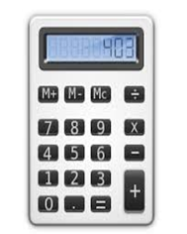

No need to preach to the converted
G | KG |  | KG | G
9675 |  |  | .936
455 |  |  | 24.096
1255 |  |  | 1
42345 |  |  | 1.9
ML | L |  | L | ML
1500 |  |  | 2.367
1000 |  |  | 34.567
500 |  |  | 9.865
31800 |  |  | 10.876

Slide 43
Or is there!!!
G | KG |  | KG | G
9675 | 9.675 |  | .936 | 936
455 | .455 |  | 24.096 | 24096
1255 | 1.255 |  | 1 | 1000
42345 | 42.345 |  | 1.9 | 1900
ML | L |  | L | ML
1500 | 1.5 |  | 2.367 | 2367
1000 | 1 |  | 34.567 | 34567
500 | .5 |  | 9.865 | 9865
31800 | 31.8 |  | 10.876 | 10876

Slide 44
Let’s try a few more conversions
Convert to Imperial
1800 g
1750 ml
37 cm
250 ml
64 cm
850 g
1.5 l
Convert to Metric
3.5 lbs
2.2 pt
18 in
6.2 lbs
6.3 pt
22 in
2 lbs

Slide 45
How did you Do?
Convert to Imperial
1800 g | 3.96 lbs
1750 ml | 3.1 pt
37 cm | 14.6 in
250 ml | .4 pt
64 cm | 25.2 in
850 g | 1.87 lbs
1.5 l | 2.6 pt
Convert to Metric
3.5 lbs | 1588 g
2.2 pt | 1250lt
18 in | 45.7 cm
6.2 lbs | 2812 g
6.3 pt | 3.6 lt
22 in | 56cm
2 lbs | 907 g

Slide 46
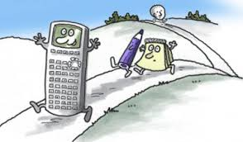
Don’t run away from calculations they are the key to making money!!!

