Slide 1
How much should we charge?
To set the selling price of any product
We must first know……..
*Food Cost
*Labour cost
*Overheads
*Net profit

Slide 2
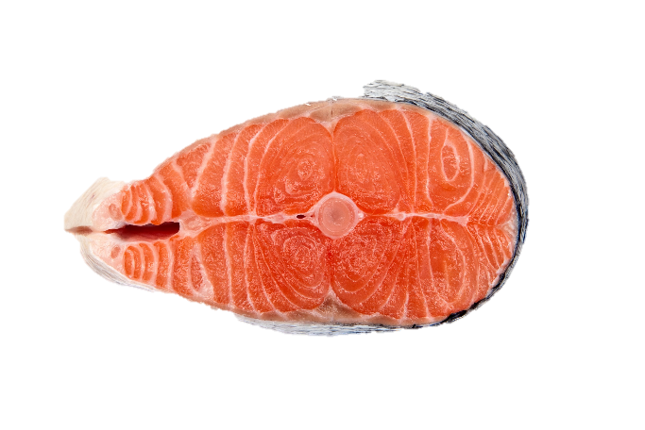
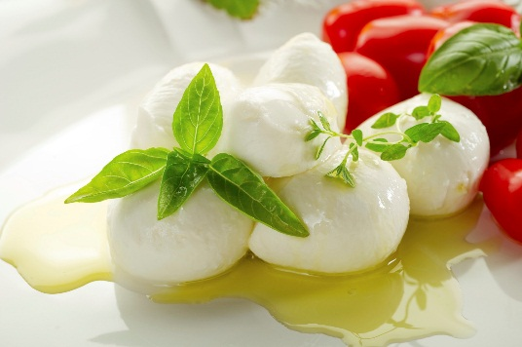

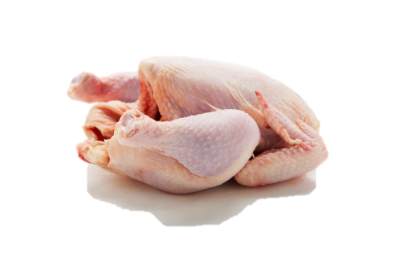
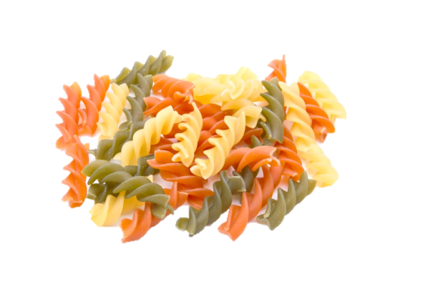

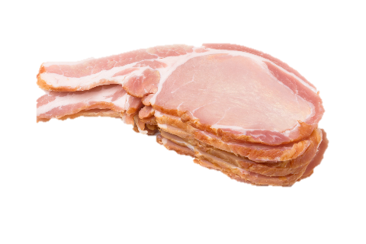
Food Cost
(food items)

Slide 3





Labour cost
(Cost of staff)

Slide 4






Overhead cost
(operational expenses)

Slide 5

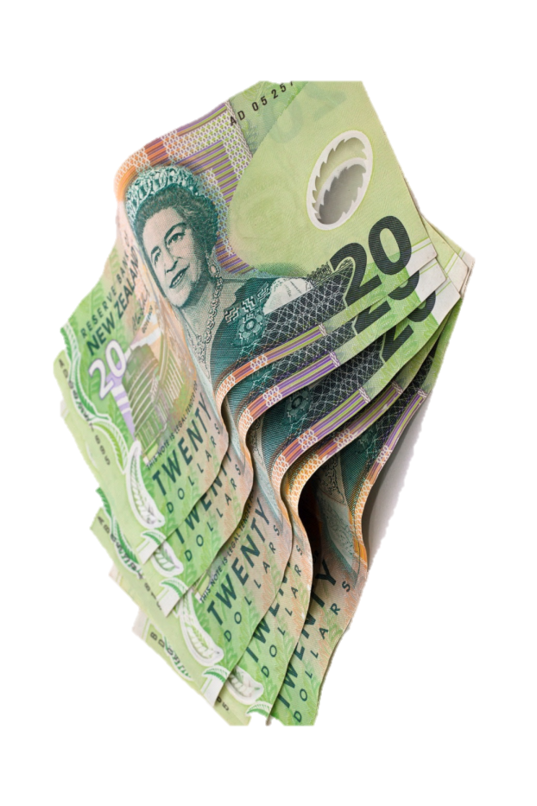
Net profit
(the amount left after all materials ,labour and over heads are paid)

Slide 6
Gross profit
(also known as a margin/mark up)
Gross profit is the amount that is
left after only the food cost has been taken out !

Slide 7

Gross profit Percentage
Executive chefs are asked to work to specific financial margins, these can include working to Gross Profit Margins
So how does this work????
We need to know 2 things
Food Cost
Gross Profit % required
Example
Your chicken salad costs $5.30 in raw materials (FC) your manager has asked what the selling price will be for the new summer menu, based on a 70% Gross Profit Margin
$5.30 (fc) ÷ 30 (fc %) x 100 = $17.666 (rounded up $17.70 selling price)

Slide 8
Calculating the selling price
Food cost ÷ food cost% x 100 =selling price(100%)
I.e. pasta food cost($1.50)÷food cost % (30%) x 100 = selling price.($5.00)

Slide 9
How to work out the cost of a dish
(food cost)
We need to find out how much product we are using ,then the price of that amount!

Slide 10

Don’t run away from calculations they are the key to making money!!!

