Slide 1
Clouds
Clouds form through condensation

Slide 2
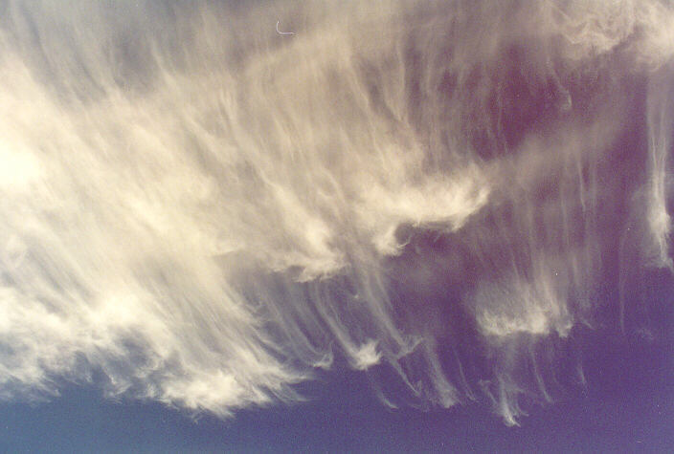
Cirrus
Could be bad weather on the way

Slide 3
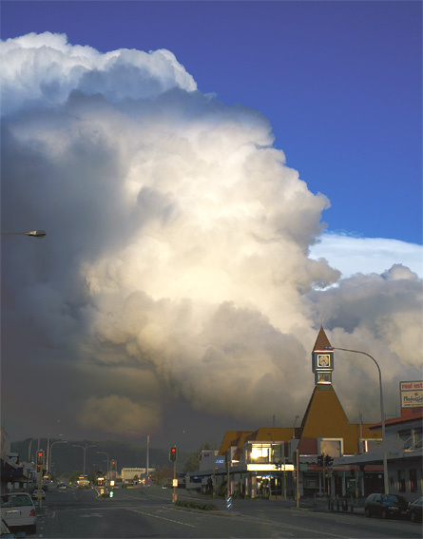
Cumulonimbus
Rain cloud

Slide 4
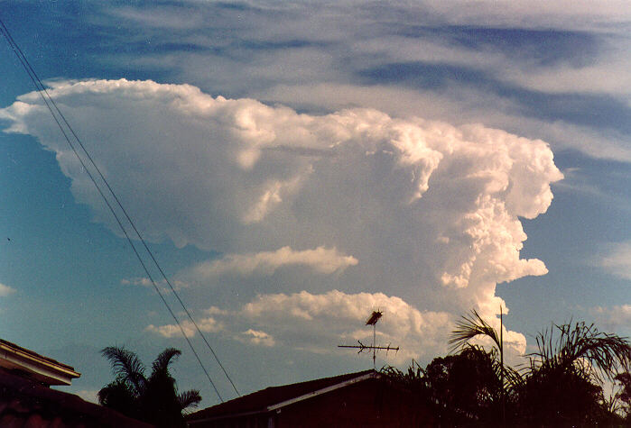
Cumulonimbus again

Slide 5
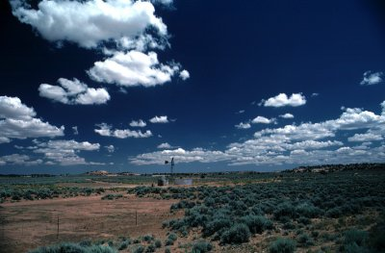
Cumulus
Fine weather

Slide 6
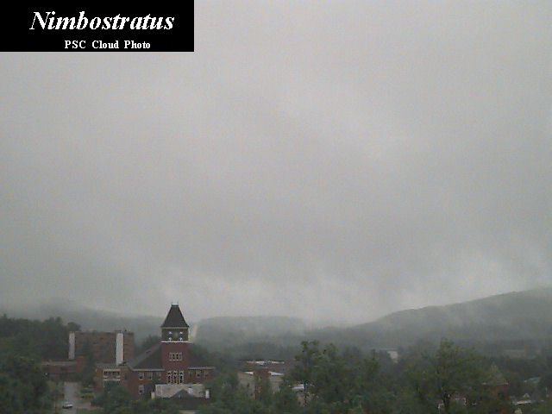

Slide 7
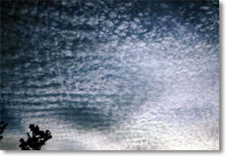
Altocumulus

Slide 8
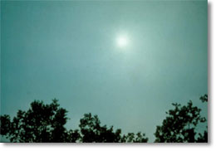
Altostratus

Slide 9
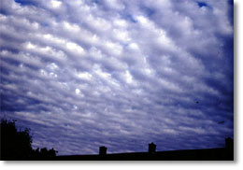
Stratocumulus

Slide 10
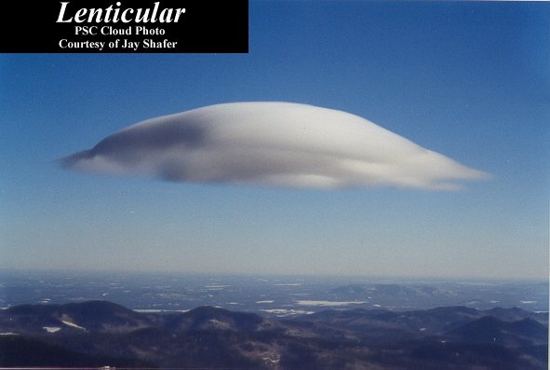

Slide 11
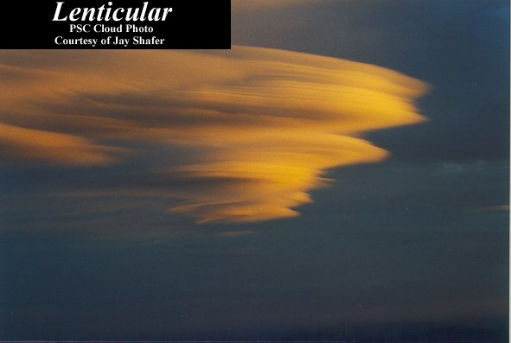

Slide 12
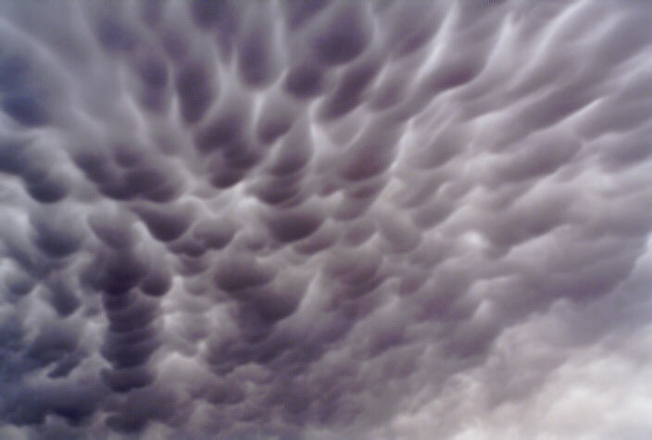
Mamatus Cloud

Slide 14

Thunder cloud formation
A thunder storm forms from a cumulus cloud when there is a rising upcurrent of warm moist air. Precipitation falls, pushing air down to create a downcurrent. The clash of air currents is responsible for the electrical activity in the cloud. This dies out when the upcurrent weakens.

Slide 15
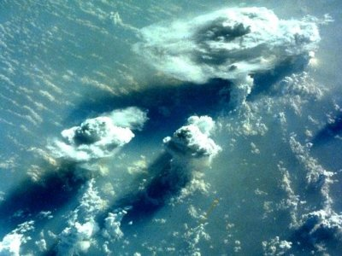
Large thunderstorms can be observed from space and contain more energy than a nuclear bomb

Slide 16
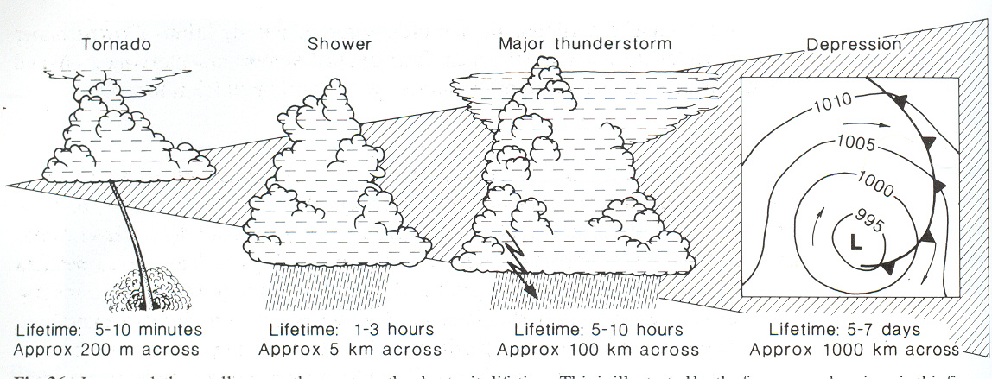
Positive Charge
Air Currents
Negative Charge

Slide 17
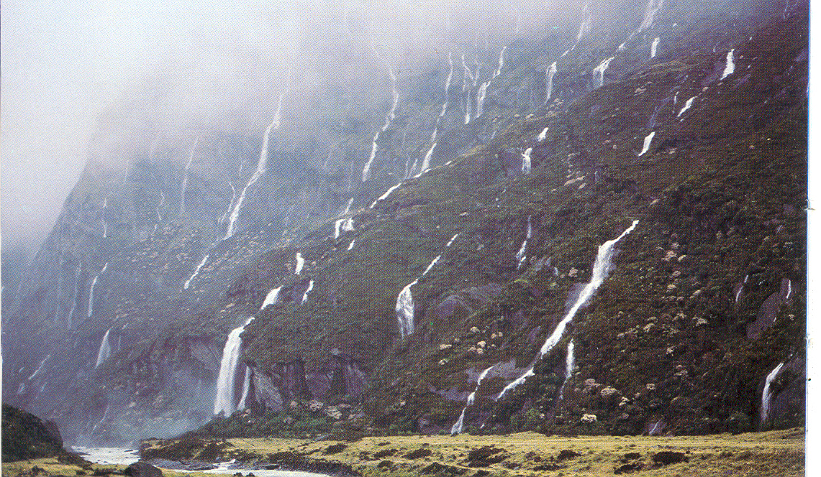
Precipitation

Slide 18
Rain develops when growing cloud droplets become too heavy to remain in the cloud and as a result, fall toward the surface as rain. Rain can also begin as ice crystals that collect each other to form large snowflakes. As the falling snow passes through the freezing level into warmer air, the flakes melt and collapse into rain drops.
Rain develops when growing cloud droplets become too heavy to remain in the cloud and as a result, fall toward the surface as rain. Rain can also begin as ice crystals that collect each other to form large snowflakes. As the falling snow passes through the freezing level into warmer air, the flakes melt and collapse into rain drops.

Slide 19
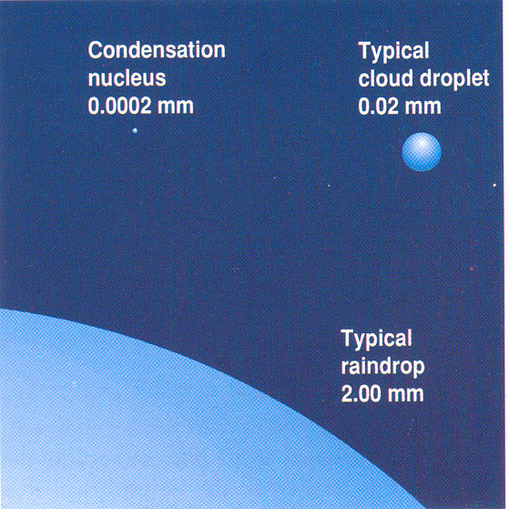

Slide 20
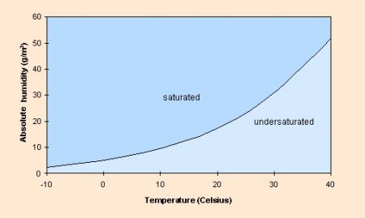
The amount of water vapour air can hold before becoming saturated is defined by the absolute humidity, which varies with temperature. The point at which water vapour condenses is known as the dew point.

Slide 21
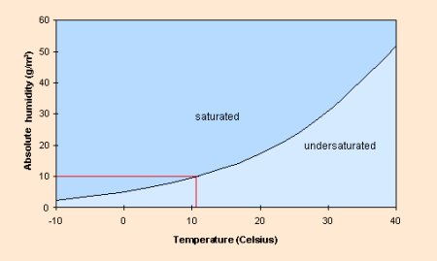

Slide 22
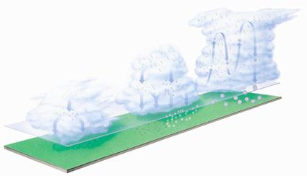
Condensation level
Cumulonimbus cloud
The type of precipitation depend on whether a cloud carries ice crystals, water droplets or both
Hail formation
Water droplets and ice crystals
Water Droplets
Dry snow
Rain
Wet snow
Drizzle – small droplets
Rain – Large droplets

Slide 23
Summary
When air contains the maximum amount of water vapour possible for the temperature it is at, the air is said to be saturated
When saturated air is cooled to its Dew Point some of that water vapour is changed back into liquid. This process is called ‘condensation’.
Warm air can hold more moisture than colder air
When water vapour condenses latent heat is released

Slide 24
Frontal Systems
A front is the boundary between two different types of air mass. In our latitudes a front usually separates warm, moist air from the tropics and cold, relatively dry air from polar regions.
Fronts move with the wind, so in NZ this is normally from west to east because our prevailing winds are from the west or northwest. At a front, the heavier cold air undercuts the less dense warm air, causing the warm air to rise up over the wedge of cold air.
As the air rises there is cooling and condensation, thus leading to the formation of clouds and rainfall. Consequently, fronts tend to be associated with cloud and rain. Three types of front can be identified; warm fronts, cold fronts and occluded fronts.

Slide 25
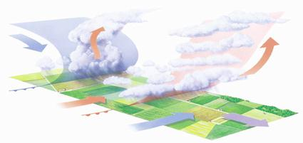
Warm and Cold Fronts
Cold Front
Warm Front

Slide 26
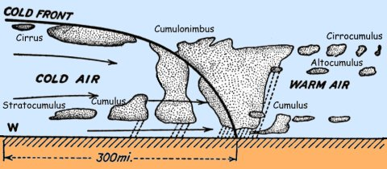
Cold Fronts

Slide 27
Cold Fronts
Pressure begins to fall increasingly rapidly as the front approaches and rain usually starts not long before it arrives, becoming heavy for a short time. This is often accompanied by an increase in and a backing of the wind. In some cases, there may also be hail and thunder.
The passage of the front is usually marked by a sharp change from falling to rising pressure and a veer in the wind.
As the rain dies away, the cloud lifts and breaks and, although there is sunshine, the air temperature falls.
After a time, cumulus clouds begin to form, often bringing showers. Sometimes the showers may become heavy, perhaps even accompanied by hail and thunder. On the other hand, in some cases, pressure will rise rapidly after a cold front has passed and this causes there to be few, if any, showers.

Slide 28
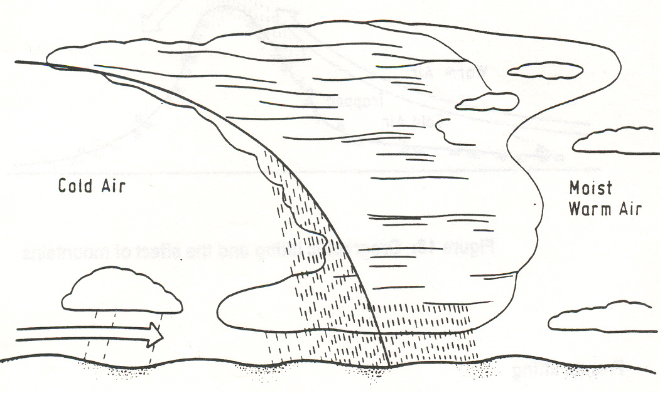
Cold front

Slide 29
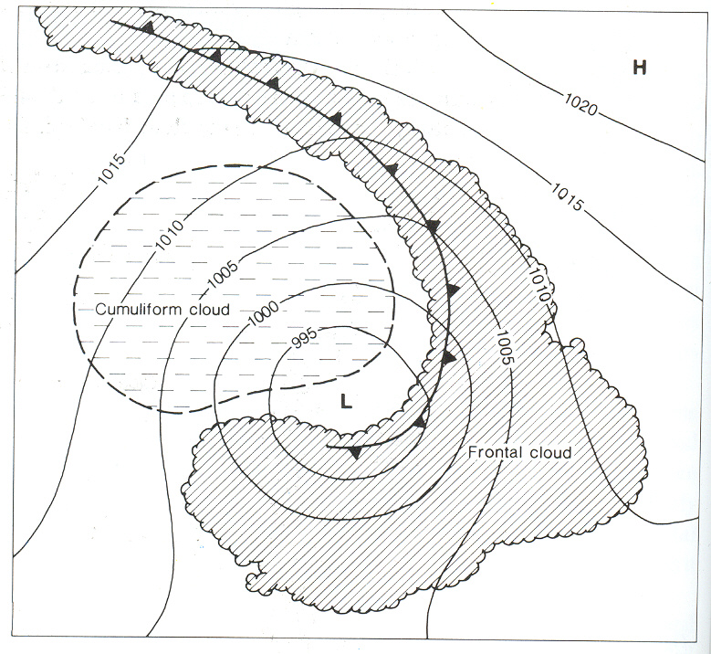
Cold front cloud

Slide 30
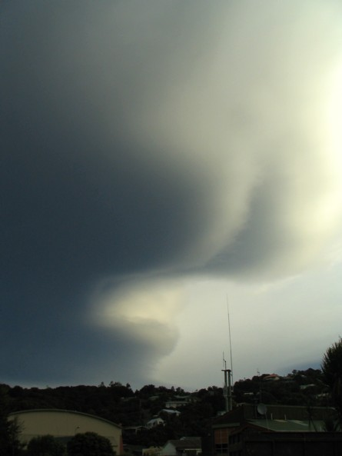
Frontal cloud Stewart Island – frontal cloud

Slide 31
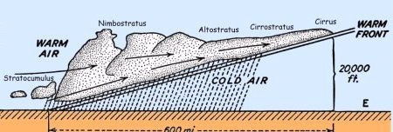
Warm Front
Warm Fronts

Slide 32
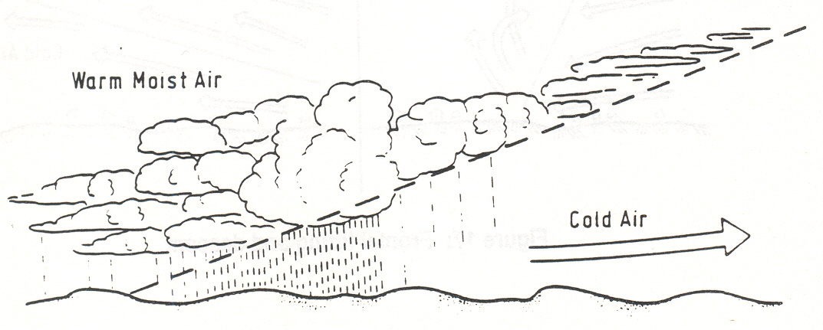
Warm front

Slide 33
A warm front marks the leading edge of a warm air mass. The presence of a warm front means that the warm air is advancing and rising up over the cold air. This is because the warm air is 'lighter' or less dense, than the colder air. Warm air is thus replacing cold air at the surface.
Cloud extends well ahead of the front, becoming thicker as the front approaches, accompanied by falling pressure. Rain then starts to fall, usually becoming heaviest on the front itself.
The passage of the front is followed by a rise in temperature and humidity and a veer in the wind, while the pressure also stops falling. Although the rain dies out, it often stays cloudy.
On windward coasts and hills, the cloud base may be low enough to give fog and thick enough to produce drizzle. Inland and to the lee of hills, the cloud may break, allowing for some warm sunshine.

Slide 34
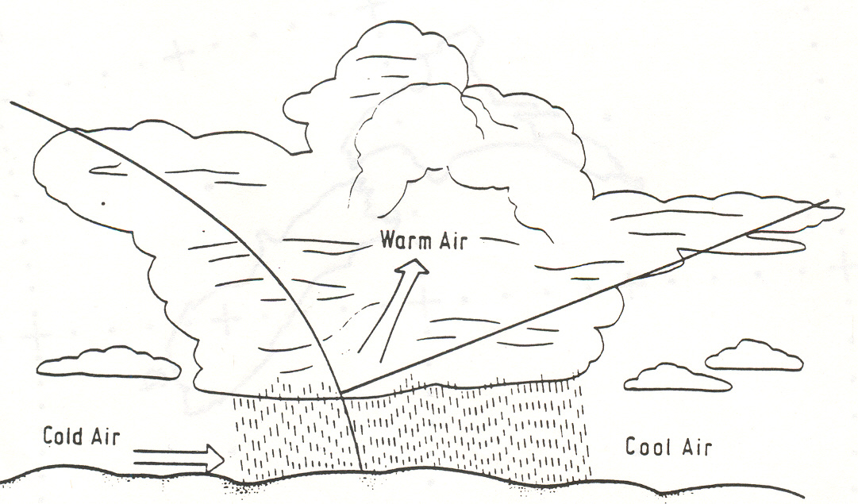
Occluded Front

Slide 35
Occlusions are slightly more complex than warm or cold fronts. They occur because cold fronts travel more quickly than warm fronts and eventually this results in the cold front 'catching up' with the warm front.
This causes the warm air to be undercut and lifted up from the surface.
The characteristics of an occlusion are similar to those of a cold front in that the rain belt is narrow.
Cloud lifts and breaks after the front has moved through and there may be a change in temperature and a veer in the wind, though these tend to be small.

Slide 36
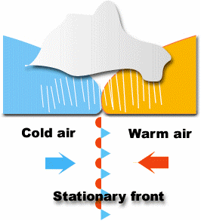
Stationary Fronts
A stationary front is when cold air is travelling in one direction and warm air meets it whilst travelling in the other direction
The main characteristic is that neither of the frontal systems is strong enough to cancel the other out.
It causes cloud and precipitation, often lasting a while in one place (because it is stationary!!)
If the front starts to move again, then it is either a cold or warm front, depending on it’s characteristics

Slide 37
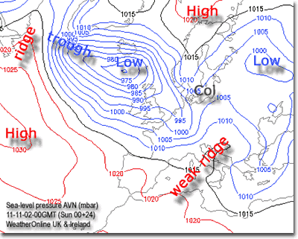
Troughs
A trough is an elongated (extended) region of relatively low atmospheric pressure, often associated with fronts
Whereas fronts separate air masses, which are different in temperature, troughs generally develop in cold air and are characterized by an increase in the frequency and intensity of showers.
Pressure begins to fall as the trough approaches and often rises sharply once it has passed. As with fronts, the wind tends to back ahead of the trough and to veer immediately behind it. There are also particularly strong gusts of wind in the showers

Slide 38
Summary
Fronts form as the result of 'conflict' between warm and cold air
Fronts are the boundary between two air masses
The most significant weather occurs on fronts, since that is where the air is rising fastest

Slide 39
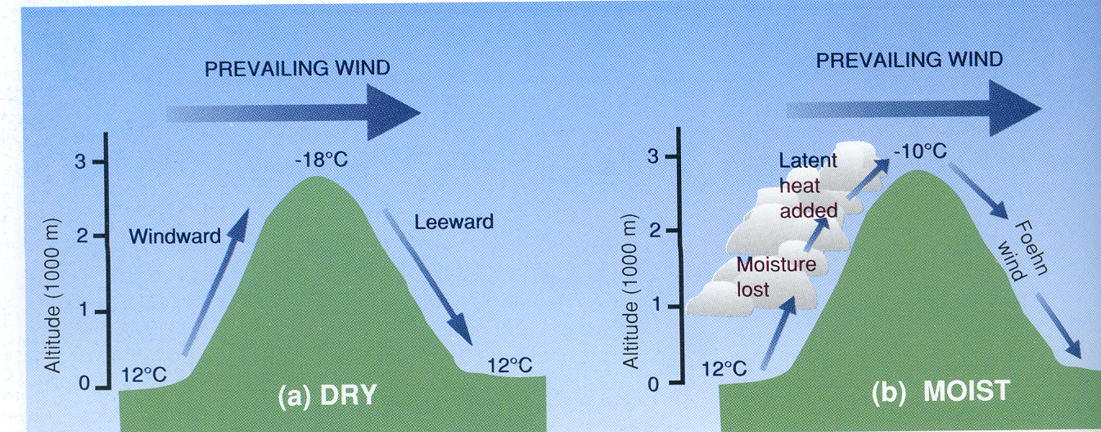
Norwester (Foehn) Winds
Foehn winds develop when air is forced to flow over a mountain range in a short period of time. The air cools rapidly as it gains altitude, cloud forms and rain or snow falls. Heat is added to the air through condensation of water vapour (latent heat) thus reducing the rate at which the air cools. When the air descends on the other side it has lost some of its moisture and it is warmed by compression as it descends. This dry warm wind is the classic South Island Nor’wester.

Slide 40
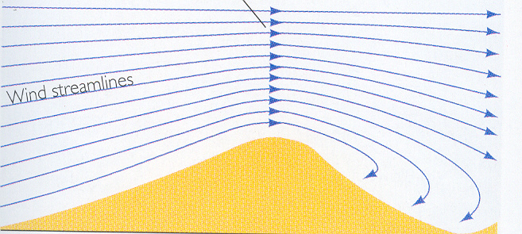
Wind speed increases over a hill or mountain and rotor winds are present on the lee slopes

Slide 41
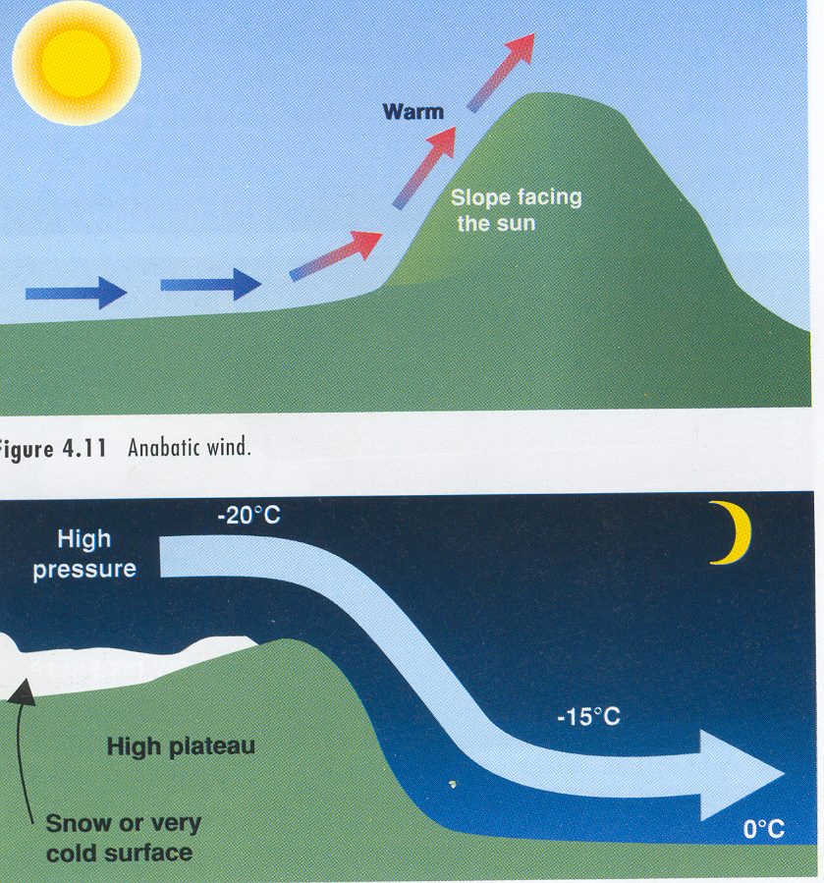
Anabatic and Katabatic Winds
ANABATIC WIND
During the day air is warmed on sunny slopes and rises uphill
KATABATIC WIND
During the night air cools and sinks downhill

Slide 42
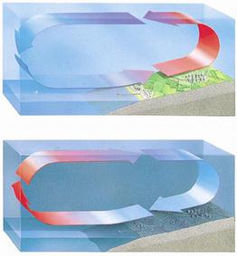
Sea and Land Breezes

Slide 43
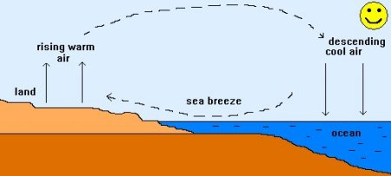
A sea breeze develops when the land become much warmer than the sea on a sunny day.

Slide 44
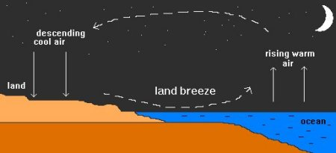
A land breeze develops when the land cools down much more than the sea during the nighttime.

Slide 45
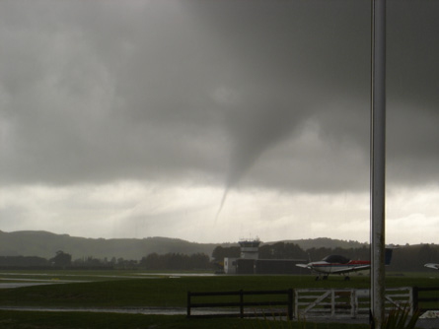
Tornados
Most tornadoes form in the presence of thunderstorms. All thunderstorms are characterised by rising or convecting air, called updrafts. These updrafts supply the warm, humid air that fuels thunderstorms. In some cases, the column of rising air becomes a vortex - a funnel cloud or tornado.

Slide 46
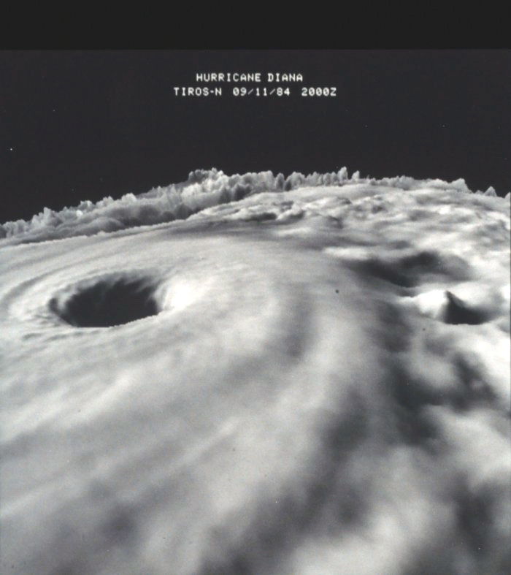

Slide 47
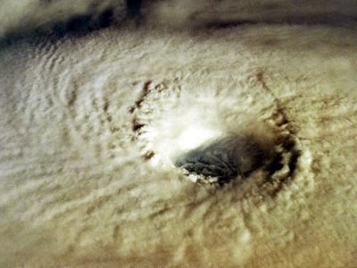

Slide 48
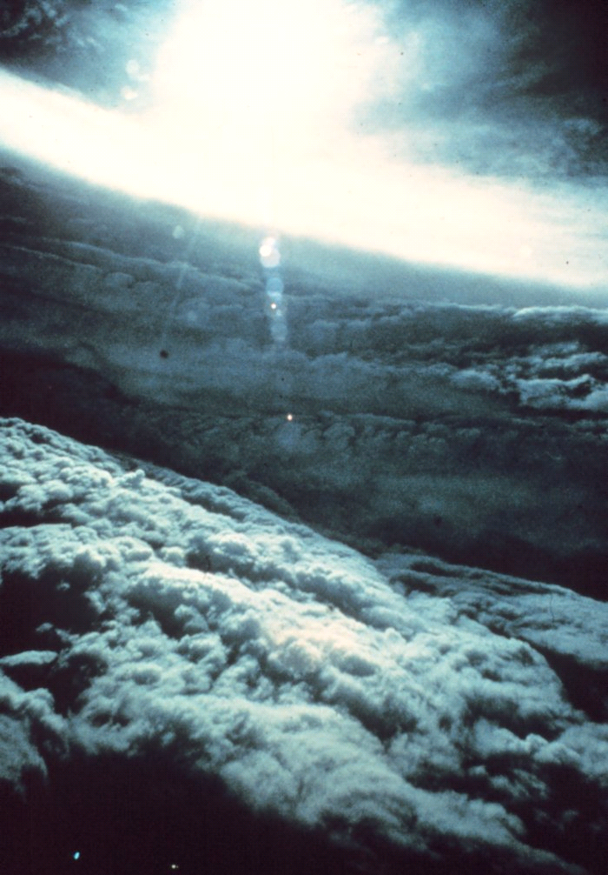

Slide 49
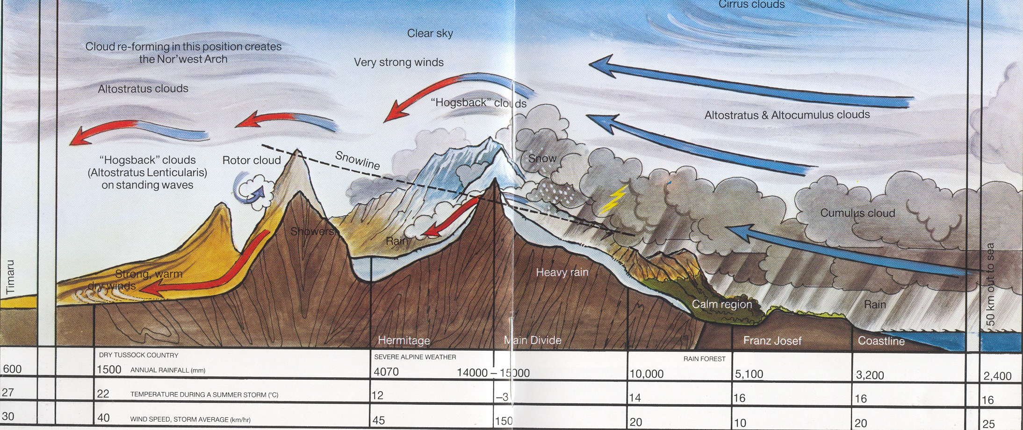
South Island Nor’west weather – Franz Josef to Timaru

